Slide 1
Wilmslow High School
AQA GCE A LEVEL ENGLISH LANGUAGE STUDENT GUIDE
Wilmslow High School
English Language A Level
AQA English Language
Student Handbook & Learning Guide
Name:
Form:
Useful links:
You can also keep up to date by following us on:
Twitter @whigh_KS5eng
DC Blog: http://englishlangsfx.blogspot.co.uk/
Firefly: https://wilmslowhigh.fireflycloud.net/english-lang

Slide 2
Wilmslow High School
AQA GCE A LEVEL ENGLISH LANGUAGE STUDENT GUIDE
ENGLISH LANGUAGE Course Outline
AQA GCE English Lang. | Unit | Weighting | Assessment
A Level ENGLISH LANGUAGE | Unit 1 Language, the Individual and Society | 40% of A Level | Exam – 2 hours 30mins
 | Unit 2 Language Diversity and Change | 40% of A Level | Exam – 2 hours 30mins
 | Unit 3 Non-Examination Assessment: Language in Action | 20% of A Level | Internally marked Externally moderated

Slide 3
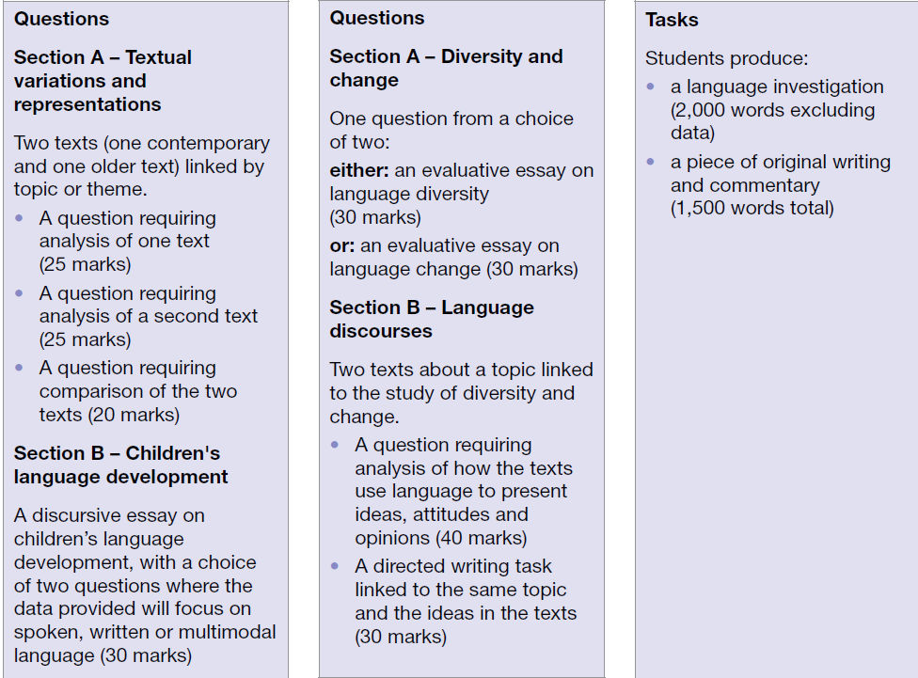
Wilmslow High School
AQA GCE A LEVEL ENGLISH LANGUAGE STUDENT GUIDE
Specification at a glance
These qualifications are linear. Linear means that students will sit all the AS exams at the end of their AS course and all the A-level exams at the end of their A-level course.

Slide 4
Wilmslow High School
AQA GCE A LEVEL ENGLISH LANGUAGE STUDENT GUIDE
English Language A Level Course Outline
Year 12 Course Outline
Paper 1: Language, the Individual and the Society
Paper 2: Language Diversity and Change
Non-examination assessment(NEA): Language in Action
Summer task - introduction to linguistic study on FireFly
 | Teacher 1 | Teacher 2
Autumn 1 | Introduction to linguistic methods – written language | Introduction to linguistic methods – spoken & intro to social groups
September Checkpoint Text Analysis
Autumn 1 | Introduction to linguistic methods – written Prepare for text analysis | Paper 2 – Language Diversity and Change Language and Social Group/Power Evaluative essay writing skills /Directed writing for P2 Q4
Assessment week Linguistic Test
Autumn 2 | Paper 1 – Language, the Individual and the Society Section A: Meanings & Representations | Paper 2 – Language Diversity and Change Age and occupation Evaluative essay writing skills/Directed writing for P2 Q4
Folder scrutiny week December (before end of term)
January Examinations TBC Timed essay: Paper 1 Section A Timed essay: Paper 2 Evaluative essay
Spring 1 | Paper 1- Language, the Individual and the Society CLA | Paper 2 – Language Diversity and Change Language and Gender Evaluative essay writing skills/Directed writing for P2 Q4
Spring 2 | Paper 1- Language, the Individual and the Society CLA | Paper 2 – Language Diversity and Change Language and Region Evaluative essay writing skills/Directed writing for P2 Q4
Assessment week Timed essay: Paper 1: Section B Timed essay: Paper 2: Q1 Evaluative essay
Summer 1 | Paper 1- Language, the Individual and the Society Examination Revision: Paper 1 | Paper 2 – Language Diversity and Change Examination Revision: Paper 2
Summer 2 | NEA preparation | NEA preparation
Year 12 Summer Exam weeks TBC Paper 1: Language, the induvial and society – full paper spoken CLA 2 hours 30mins Paper 2 – Language Diversity and Change: Evaluative essay 1 hour
Summer Task: NEA preparation

Slide 5
Wilmslow High School
AQA GCE A LEVEL ENGLISH LANGUAGE STUDENT GUIDE
English Language A Level Course Outline
Year 13 Course Outline
Paper 1: Language, the Individual and the Society
Paper 2: Language Diversity and Change
Non-examination assessment (NEA): Language in Action
Summer task 12 into 13 NEA preparation
 | Teacher 1 | Teacher 2
Autumn 1 | NEA Original Writing Paper 1- Language, the Individual and the Society Framework booster | NEA Investigation Paper 2 – Language Diversity and Change Language change and World Englishes
Coursework progress check
Assessment week NEA draft – Early December
Autumn 2 | Paper 1- Language, the Individual and the Society CLA Revision | Paper 2 – Language Diversity and Change Language Discourses Paper 2 Q3/Q4
Mock Examination January Full Paper 1 Evaluative question Paper 2 (in class)
Spring 1 | Paper 1- Language, the Individual and the Society Feedback on exam – focus on weak areas for Section A/B | Paper 2 – Language Diversity and Change Language Discourses Paper 2 Q3/Q4
Assessment week NEA Final Deadline
Spring 2 | Paper 1- Language, the Individual and the Society Revision | Paper 2 – Language Diversity and Change Revision
April Internal mock Paper 1: Language, the induvial and society & Paper 2: Language Diversity and Change 2 hours 30mins
Summer 1 | Feedback and revision | Feedback and revision

Slide 6
Wilmslow High School
AQA GCE A LEVEL ENGLISH LANGUAGE STUDENT GUIDE
Folder Scrutiny
Target Grade
Date of monitoring | Notes (organised with dates and titles) | Marked essays | Course handbook (attainment tracker completed to date) | Evidence of wider reading | WWW/EBI
Organising Notes and Resources
All students must purchase an A4 ring-bound folder in which to keep:
All lesson notes (with clear dates and titles)
Any additional resources given out by your teacher
Marked essays
Wider reader notes
Your copy of the course handbook
At least once a term, your folder will be monitored to ensure that you are managing your resources effectively. The dates for the folder checks are marked on the course outline and on the table below.
It is your responsibility to ensure that your folders are available for checking during these weeks: if you fail to produce your folder, then you will be referred for further monitoring.

Slide 7
Wilmslow High School
AQA GCE A LEVEL ENGLISH LANGUAGE STUDENT GUIDE
Knowledge Organisers (KO)
Contents:
Page 8- “Which Word Class?” Flow Chart
Page 9- Written Language KO
Page 12- Spoken Language KO
Page 15- Child Language Acquisition KOs
Page 15- CLA Spoken KO
Page 17- CLA Reading KO
Page 18- CLA Writing KO
Page 21- Language & Gender KO
Page 24- Language & Social Groups KO
Page 26- Language & Power/Occupation KO
Page 29-Language & Region KO
Page 33- Language Change KO

Slide 8
Which word class is it?
Yes
No
Start here:
Can you say:
“It is a/some…”?
It is a cat.
It’s a NOUN
Is it something you can touch?
It is a CONCRETE NOUN
Table, car, sandwich, book
It is an ABSTRACT NOUN
Heroism, achievement, disaster
Does it begin with a capital letter?
Manchester, April, Oprah
It is a PROPER NOUN
France, Michelle, Friday
See also PRONOUNS
He, she, we, they, them, those
Can you say:
“It is…”?
It is awful.
Does it end in “–ing”?
It is swimming
Can you put “so” in front?
It is so boring.
It is a PRESENT PROGRESSIVE VERB
Talking, sharing, remembering
It’s an ADJECTIVE
Does it tell you who owns it?
It is a POSSESSIVE ADJECTIVE
Mine, yours, hers, ours
Does it tell you about the state it’s in?
It is old/ dirty/ tired/ courageous
It is a DESCRIPTIVE ADJECTIVE
Enormous, green, poisonous
Does it tell you how much there is?
Some, all, very, most.
It is a NUMERAL ADJECTIVE
Some, all, many, most, none
It’s an VERB
Can you say:
“I want to…”?
Is it something you can do?
I can lean.
It is an INFINITIVE VERB
Yell, go, boast, win, make
Does it have an “-ed” on the end?
I leaned.
It is a PAST TENSE VERB
Yelled, boasted (Irregular eg won, made)
Does it have an “-s” on the end?
He leans.
It is a PRESENT TENSE VERB
Believes, sings, creates, worries
Does it give detail about an event?
Quickly, loudly, always, last night
It’s an ADVERB
Does it tell you about how something happened?
It is a MANNER ADVERB
Surprisingly, barbarically, hilariously
Does it tell you when it happened?
Yesterday, always, tomorrow
It is an TEMPORAL ADVERB
Often, last night, most of the time.
Does it tell you where something is in space or time?
On, before, whilst, with, amongst
It is a PREPOSITION
Here, in, up, down, at, between, beneath.
8

