Slide 1
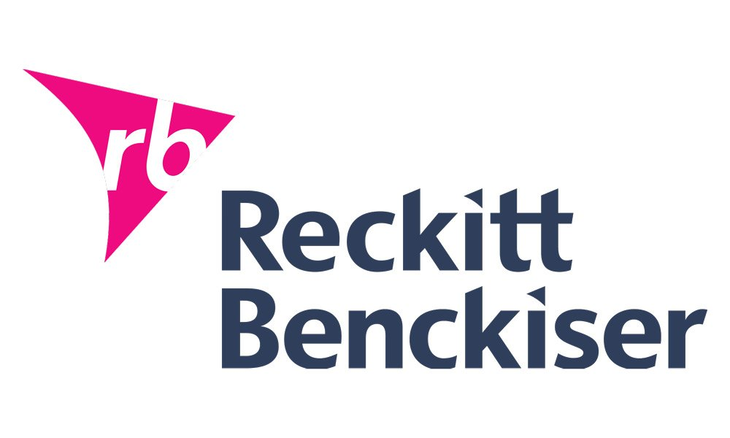
The effect of Covid-19 on Business Decision-Making
Emma Jackson

Slide 2
Background
Reckitt Benckiser is one of the world’s biggest consumer goods companies, operating in more than 60 countries, employing more than 40,000 people and generating pre-tax profits of £2.5 billion on revenue of £11.5 billion in its last financial year.
The company, Reckitt & Coleman, was formed in 1819 and merged with a Dutch company, Benckiser, in 1999.
RB has two divisions: health goods, including Nurofen, Gaviscon, Strepsils and hygiene brands including Dettol, Air Wick freshener, Harpic bleach, Calgon, Finish, Cilit Bang and Vanish.
RB competes with companies such as Unilever, Procter & Gamble and Johnson & Johnson.

Slide 3
The COVID-19 crisis comes after a disappointing year financially for RB in 2019.
It cut its revenue growth forecast for 2019 as a result of disappointing trading in the third and fourth quarters. As a result, shares in the company fell 262p (4.5%).
It reported a £2.1 billion loss for the 12 months ending 31 December 2019, compared with a profit of £2.7 billion in 2018.
Before the crisis, RB had been facing several challenges, including a $1.4 bn payment to resolve investigations into its addiction treatment, a flopped footcare product, a cyber attack, supply chain mishaps and a damaging safety scandal.

Slide 4
Finance since January 2020
Sales have risen 13.3% to £3.5 billion in the 3 months to the end of March 2020, far outpacing its forecast. This has been the biggest quarterly increase since the company was formed in 1999.
Its shares closed up 228p (8%) which is one of the best performers on the FTSE 100 index.
In February 2020, RB announced plans to spend £2 bn over the next three years to spur growth and cut costs. Although the plan is underway, the COVID-19 crisis has meant that some investments will have to be pushed back to start later in the year. Some of these intended investments are having to be diverted to make more hygiene and cleaning supplies and to buy equipment and raw materials to help increase production.
On 30 April 2020, RB posted its strongest sales growth since its merger 2 decades ago.
RB is expecting higher operating costs, particularly in its supply chain.

Slide 5
Marketing
RB’s product portfolio has been affected as it has made the decision to simplify its product ranges to boost volumes of its most popular products.
It has launched a £32 mn “Fight for Access” fund, equivalent to 1% of its operating profit, to combat Covid19 – a global marketing push to encourage better hygiene.
As a response to the virus, it has funded a coronavirus global facts website and a TikTok social media campaign to encourage people to wash their hands properly for 20 seconds which has received 90 billion views to date.
Its sales stand to benefit from a world-wide, virus-inspired health and cleanliness drive.

Slide 6
Marketing drives have included a Dettol UK pledge to donate 150,000 care packages and £1 mn worth of aid, to support NHS workers.
In order to promote its virus-related products, RB has tried to harness the power of social media, but has been hit by online rumours about the safety of Ibuprofen in treating COVID-19.
RB has handed over advertising space to HM government to support its vital public health communications. This donation will allow increased coverage of the public service messages on tv. The company has also launched a new social media campaign from Dettol echoing government guidelines.
RB is among the brands backing a campaign urging people to shop more responsibly during the COVID-19 pandemic. It will feature on retailers’ websites, in email communications and is accompanied by a #ShopResponsibly social media campaign.

Slide 7
Operations
Despite the rest of the country shutting down, RB’s factories have continued to operate in order to meet the unprecedented demand for its most popular products, eg Dettol.
Production has been stepped up at its factories in Derby, Nottingham and Hull.
The decision has been made to cut its product range to meet demand for its most popular cleaning products. In May 2020, the company will produce the equivalent amount of sanitiser that it made in the whole of 2019.
As a result, the company is facing short term operational challenges as it tries to meet the additional demand and handle the imposed lockdown and social distancing measures, all of which have associated costs.
RB has been battling with problems with its supply chain and distribution channels as suppliers and distributors have gone into lockdown.

Slide 8
RB’s new Chief Executive had been planning many ambitious organisational changes, including productivity efficiencies and raising retailers stock in 2020. In the current climate, it has been decided to put many of these changes on hold.
RB has reprioritised its manufacturing activities in order to maximise throughput and expediting raw materials and finished products as quickly as possible.

Slide 9
Human Resource Management
In these unprecedented times and unlike many other employees who have been furloughed or made redundant, RB’s factory workers are working flat out and are being put up in nearby hotels to limit the spread of infection.
Laxman Narasinhan joined RB as Chief Executive in September 2019 and is having to run the company from his 2 bed home in West London whilst looking after his 79 year old mother.
Despite the significant pressures presented by COVID-19, RB’s global teams have been working around the clock to ensure continuity of supply while prioritising the safety of employees, partners and the communities where they live and work.

Slide 10
RB are using volunteers to help with packaging.
In response to the crisis, RB has created dedicated teams, working closely with customers and suppliers, to ensure they increase capacity and sustain continuity of supply across the critical parts of their product range. This has involved ensuring a safe working environment for all their staff.

Slide 11
Demand
Sales of Dettol cleaning products have soared because of the COVID-19 crisis, prompting supermarkets to ration how many articles customers can buy. RB has strong consumer loyalty but this unprecedented demand has resulted in some customers and consumers facing shortages for some of their products. RB has responded by ramping up production, streamlining out SKUs and working with customers and suppliers to overcome significant barriers while incurring additional costs.
This boom in demand has come as the company had been battling intense competition in the health and hygiene industry.
Confusion over its effectiveness and safety has lead to stacks of Nurofen products being left on the shelves while Paracetamol and other painkillers are sold out.

Slide 12
There has been a surge in consumers stockpiling Dettol. The split between defensive buying (stockpiling) and higher levels of underlying consumption is unclear. It is uncertain how quickly this will change in the months ahead and RB will need to be alert to any changes in demand. RB could face an easing of demand over the next few months as consumers work through soap and disinfectant stock in their cupboards.
RB faces pressure on sales from low cost competitors including supermarkets’ own brand goods.

