Slide 1
Task 1: Shakespeare’s Richard III: Researching Richard’s family tree
1. Research key historical figures relevant to ‘Richard III’
2.Organise your information into a family tree to help you to understand the relationships between them

Slide 2
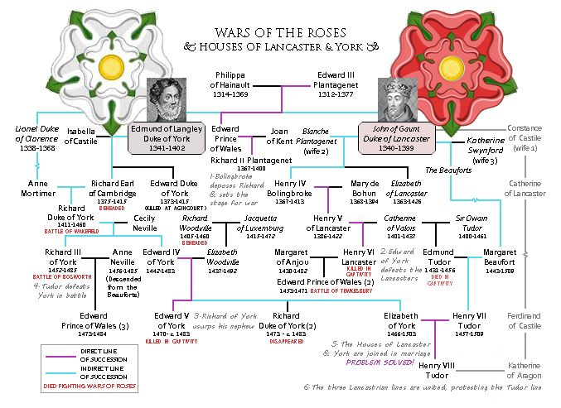
Task 1: Shakespeare’s Richard III: Researching Richard’s family tree
The play is based on the life and death of a real king of England. To help you get to grips with the large cast of characters, complete your own family tree for Richard III and his immediate family.
Include the following people (their relationship to Richard is indicated in brackets)
Richard, Duke of York (father)
Ceily Neville, Duchess of York (mother)
Edward IV (brother)
Edmund, Duke of Rutland (brother)
Elizabeth Woodeville/ Grey/Queen Elizabeth (Edward’s wife)
Edward, Prince of Wales (nephew)
Richard, Duke of York (nephew)
Elizabeth of York (niece)
Richard, Duke of Gloucester/King Richard III
George, Duke of Clarence (brother)
Edmund, earl of Rutland (brother)
Anne Neville (wife)
http://www.raucousroyals.com/lookandlearn/familytrees/lancasterandyork.pdf

