Slide 1
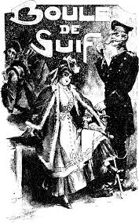
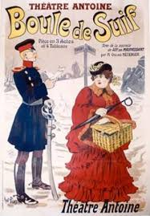
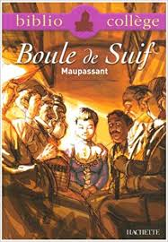
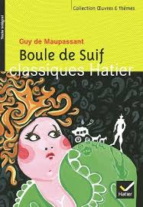

Slide 2
Boule de suif
1 Examine how Maupassant uses the relationship between Boule d e Suif and the other travelers to show the latter’s hypocrisy
2 Analyse whether Maupassant’s opinion about human nature is more positive or negative in the short story Boule de Suif
3 “Maupassant wants us to understand how war affects the lives of normal people” – referring to two stories, to what extent do you agree with this statement
4 Analyse how war provokes extreme reactions in Maupassant’s characters

Slide 3
AO4
17-20 | Excellent critical and analytical response to the question set Knowledge of the text or film is consistently accurate and detailed. Opinions, views and conclusions are consistently supported by relevant and appropriate evidence from the text or film. The essay demonstrates excellent evaluation of the issues, themes and the cultural and social contexts of the text or film studied.
13-16 | Good critical and analytical response to the question set Knowledge of the text or film is usually accurate and detailed. Opinions, views and conclusions are usually supported by relevant and appropriate evidence from the text or film. The essay demonstrates good evaluation of the issues, themes and the cultural and social contexts of the text or film studied.
9-12 | Reasonable critical and analytical response to the question set Knowledge of the text or film is sometimes accurate and detailed. Opinions, views and conclusions are sometimes supported by relevant and appropriate evidence from the text or film. The essay demonstrates reasonable evaluation of the issues, themes and the cultural and social contexts of the text or film studied.
5- 8 | Limited critical and analytical response to the question set Some knowledge of the text or film is demonstrated. Opinions, views and conclusions are occasionally supported by relevant and appropriate evidence from the text or film. The essay demonstrates limited evaluation of the issues, themes and the cultural and social contexts of the text or film studied.
1-4 | Very limited critical and analytical response to the question set A little knowledge of the text or film is demonstrated. Opinions, views and conclusions are rarely supported by relevant and appropriate evidence from the text or film. The essay demonstrates very limited evaluation of the issues, themes and the cultural and social contexts of the text or film studied.

