Slide 1
Useful Coping Strategies for Anxiety
Self-care:
Looking after yourself and planning times each day and throughout the week for self-care is an important strategy for dealing with stress and anxiety. Create a self-care plan for the week ahead including short and longer activities which help you to relax and feel better. Here are a few ideas to get you started…
For more ideas have a look at: https://www.annafreud.org/on-my-mind/self-care/
Day | Monday | Tuesday | Wednesday | Thursday | Friday | Saturday | Sunday
Morning | Listen to music (5 mins) | Breathing practice (5 mins) | Look at photos on phone (5 mins)
Afternoon | Make a hot chocolate (10 mins) | Sports club (1 hour) | Go for a run or walk after school (30 mins) | Dance or basketball club (1 hour) | Do some cooking or baking (1 hour) | Meet up with friends | Shopping
Evening | Watch a favourite programme | Chat to friends (45 mins) | Do some art or a craft activity (45 mins) | Do some yoga (30 mins) |  | Go out to the cinema (2 hours)
Wilmslow Youth
Registered Charity 1182727

Slide 2
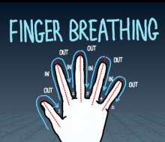
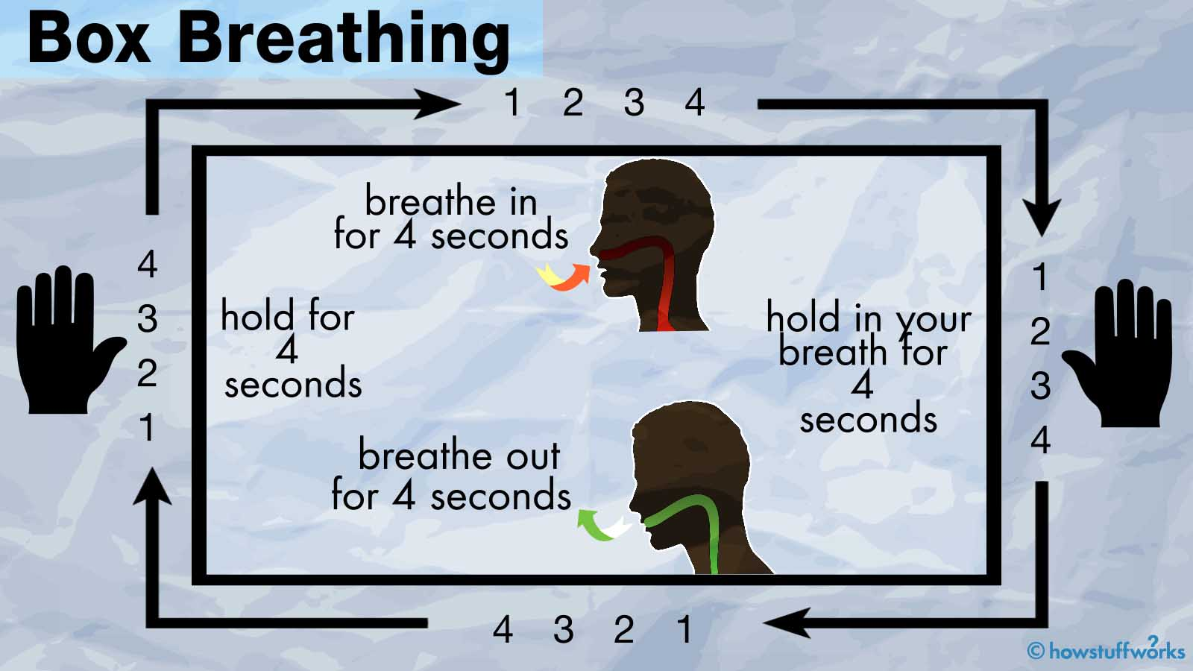
Breathing Techniques:
There are lots of different breathing techniques for helping us to calm down and feel less stressed. These can take a few minutes to practise or longer, depending on how much time we have…
Start by placing one hand in front of you and spread your fingers apart
Using the index finger of the opposite hand, begin to trace up the outside of the thumb as you inhale
Trace down the inside of the thumb as you exhale
Repeat this for the remaining fingers making sure to inhale as you trace up the finger and exhale as you trace down
Pause and repeat as needed
The 7/11 Breathing Practice can be particularly useful for coping with panic attacks
In your head, count up to 7 as you breathe in, and then count up to 11 as you breathe out.
Just breathe how you normally breathe. There is no need to change your breathing in any way. Fit the numbers to the breath, rather than the other way around.
If you have to speed up the counting in order to get to 7 or to 11 by the end of the in-breath or out-breath, that’s fine.
You may find it easier to do the 7-11 on every other breath, rather than every one. Or you could count to 4 on the in-breath and 7 on the out-breath
Wilmslow Youth
Registered Charity 1182727

Slide 3
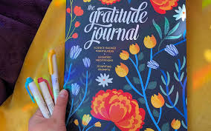
Practising Gratitude…
The Gratitude Practice was developed by the psychologist Martin Seligman – it can be done each night before you go to sleep. Before you go to sleep, think of three things you are grateful for, such as something you ate, your physical health or something kind which a friend said to you today.
Research has shown that participants doing this exercise for one week increased happiness and decreased depressive and anxiety symptoms for six months!
Wilmslow Youth
Registered Charity 1182727

