Slide 1
Programming Errors
Key Revision Points

Slide 2
TYPES OF ERROR
Three types of error occur in programming:
Syntax Errors
Logical Errors
Run time Errors

Slide 3
SYNTAX ERRORS
Syntax = spelling, punctuation, grammar of a language
Syntax errors occur when you enter code the compiler or interpreter doesn’t understand
Misspelled commands or variable names
Missing punctuation – brackets, speech marks etc.
Incorrect indentation

Slide 4
SYNTAX ERRORS
Easiest type of error to detect and correct
Compiled languages wont compile with syntax errors

Slide 5
LOGIC ERRORS
Logic errors occur when there is a fault in the logic or structure of the problem.
Logic errors can be difficult to detect as they do not usually cause a program to crash.
However, logic errors can cause a program to produce unexpected results

Slide 6
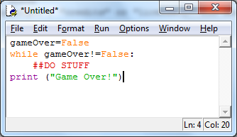
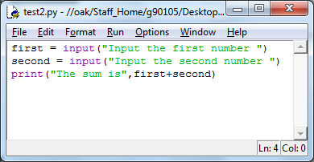
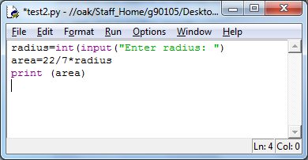
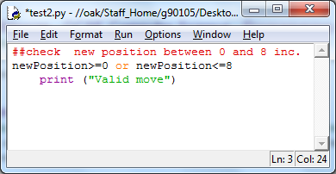
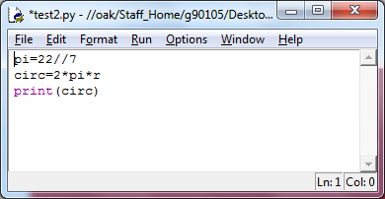
LOGIC ERROR EXAMPLES

Slide 7
LOGIC ERROR DETECTION
Logic errors are detected through systematic testing to a test plan
See pptx on testing

Slide 8
RUN TIME ERRORS
Run time errors or exceptions may cause the program to crash
They occur when the program receives unexpected or exceptional data:
Trying to do a mathematical operation on a string
Trying to convert a non-numeric string to an int
Division by zero
Out of range list indexes

Slide 9
RUN TIME ERRORS
Run time errors can be avoided by programming defensively
Try/except
Validation in a while loop
If/else
Programmers try to anticipate how users might misuse the program and then try to prevent it from happening
Well maintained (commented/annotated) code is also defensive programming – anyone using/adapting/updating your code will know exactly what range of values the code should accept

