Slide 1
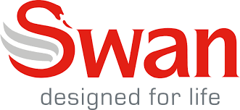
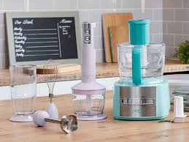
The effect of Covid-19 on Swan
An electrical appliance company

Slide 2
Finance
Swan is a company that is 80% online as a brand meaning due to the increase in online shoppers they have actually seen an increase in sales. When I asked one of the owners he felt cash flow had not suffered due to the pandemic.
However whilst we spoke about costs he mentioned the cost of shipping products had risen which would effect their profits.
We also spoke about their source of finance and I was told they had recently moved banks to HSBC and they don’t plan to change.
Finally I asked if the objective of the company had changed since this pandemic. The objective was “direct to consumer” and when I asked if it had changed he said he felt this pandemic had shown they picked the right objective and that they would not be changing it.

Slide 3
Marketing
As I mentioned before distribution costs have gone up meaning it was costing swan more to distribute their products.
The costs, they said, have stayed the same and that things such as the exchange rate would have effected them more than this.
Most of Swan’s marketing is online so not much has changed for them in this section.

Slide 4
Operations
I was assured the quality of the products have remained outstanding during this time and that they aim to keep it that way.
Their method of production I thought was effected in an interesting way. Their production is all in China meaning they suffered most when China was at the peak of its pandemic but now China are back into every day life meaning production is on a rise once again.

Slide 5
Human Resources
The management style has changed drastically due to everyone working at home at the moment. The managers at Swan are using “Zoom” to hold regular meetings.
I also asked about work force planning and I was amazed to hear this company have not furloughed anybody.
Finally I asked about how to keep the workers motivated in times like these and I was told each department has a weekly zoom quiz and there are daily zoom meetings to examine progress of employees.
Overall the owner told me he feels that for the business this pandemic has had a “good change”.

