Slide 1
ARRAYS 1
GCSE COMPUTER SCIENCE

Slide 2
Objectives
By the end of this session you should be able to:
Understand what a data structure is
Understand and be able to program with one dimensional arrays
Understand how data structures can make coding a solution to a problem simpler

Slide 3
RECAP previous
So far we’ve looked at basic data types such as strings, ints, floats and bools and how to store these as variables
Often we need to store lots of variables of the same type for the same purpose – it therefore makes sense to collect all those items together in a single data structure to simplify our programs

Slide 4
TASK
Create a program in Python that can be used to store the names of 5 people who you’d like to invite to your party:
Ask the use to input the 5 names (one at a time), store the names in 5 variables and then output to the screen the a list of the 5 names entered
OUTPUT “Who would you like to invite to your party?”
Person1 ← USERINPUT
Person2 ← USERINPUT
…
OUTPUT “You’ve invited the following people:”
OUTPUT person1
OUTPUT person2
…

Slide 5
SOLUTION
In the previous task you have created 5 variables called something like person1, person2, person3 etc.
This isn’t very efficient as it requires 5 lines of code to input /store our variable data and 5 lines to output it– the longer the list the less efficient our program would be e.g. to store the 26 letters of the alphabet would need 26 lines of code
A more efficient solution is to use a single data structure to store the variable data
In this presentation we concentrate on one dimensional arrays

Slide 6
ARRAYS
One type of data structure is an array*
An array is a group of variables of the same data type
The members of the array are called elements
Each element has the same variable name but is distinguished by an index number that identifies its position in the array

Slide 7
Variable vs. ARRAY
We could create a separate variable for each of our party guests
However, because the variables are all the same type (strings) and going to be used for the same purpose (to plan our party) it makes sense to group them together in a single data structure
*p=person
John
p1
Paul
p2
George
p3
Burt
p4

Slide 8
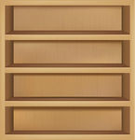
VARIABLE VS. ARRAY
You can think of a one dimensional array as being like a book case with a separate shelf for each data item or element
partyGuests
John
partyGuests[1]
The array (bookcase) is named partyGuests and each element (shelf) has the same name but a unique index or element number
Paul
partyGuests[2]
George
partyGuests[3]
Burt
partyGuests[4]

Slide 9
VARIABLE VS. ARRAY
Another way to visualise a one dimensional array is to think about a table which can have many rows but only one column containing data
partyGuests
Index | Content
1 | John
2 | Paul
3 | George
4 | Burt

Slide 10
PYTHON “ARRAYS”
Python does not have a built-in array type but it does have something similar called a list
Like other data types lists do not have to be declared in Python before we can start using them
The elements of a list are enclosed in square brackets and separated by commas

Slide 11
PREVIOUS EXAMPLE
In the previous example we created 5 variables to store our party list
We can improve this by creating a single “array” called partyList to store the 5 names. The names will be stored as elements of the array

Slide 12
VISUALISE ARRAYS/lists
partyList
In common with many programming languages, the first element of every “array” is element 0 (or at index 0) in Python (more about this later!)
Element | Content
0 | “Maddie”
1 | “Elle”
2 | “Lyndsey”
3 | “Jack”
4 | “Alex”

Slide 13
Creating lists in python
We have already seen the easiest way to create a list – give it a name and then add elements to populate it during the creation
There are two other ways we can create lists…

Slide 14
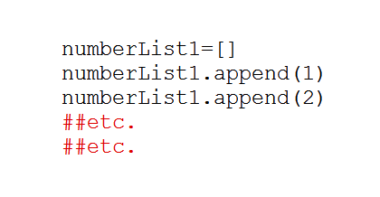
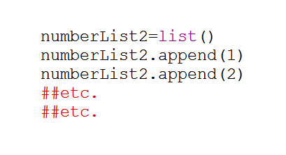
List APPEND
Both these methods start by creating an empty list and then appending (adding) elements to the list
Use which ever method you are most comfortable with

Slide 15
ACCESSING ARRAY ELEMENTS
We can access an element of an array using its index (or element) number – don’t forget they start at 0
Once accessed we can output the element, change it or use it as part of further processing
What does the above code print out?

Slide 16
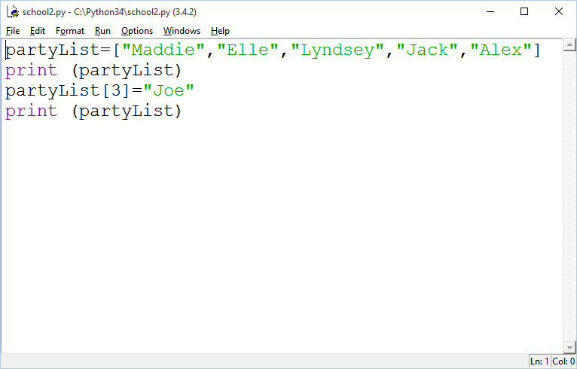
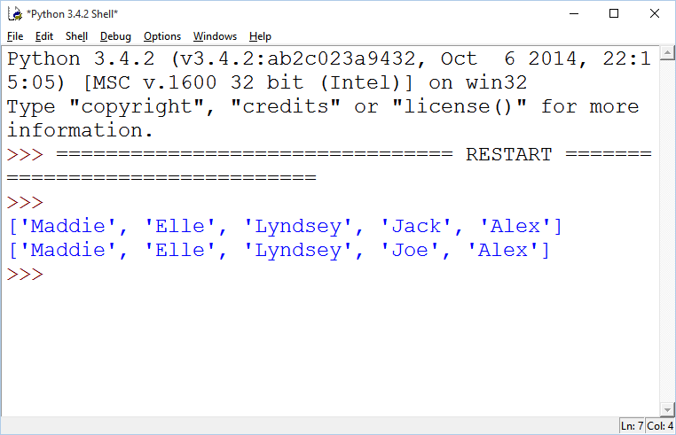
Editing array elements
We can reassign the value of any array element using its index number
partyList[3] changed from Jack to Joe

Slide 17
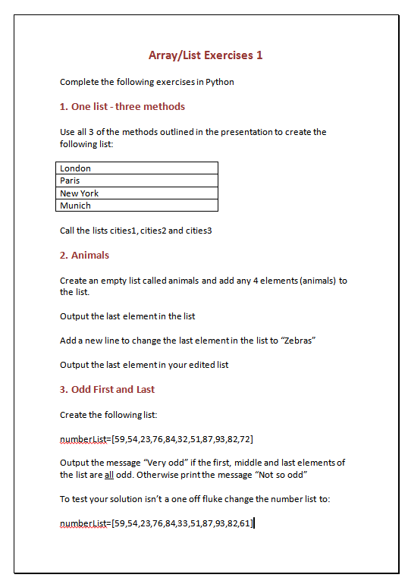
TASK
Load the document arrays1.docx and complete the 3 practical exercises

Slide 18
Add to LIsts
To add an element to an list we use the append method
array or list name
element to append
dot
method
The element is added to the end of the list so “Goldfish” would be stored in animals[4]

Slide 19
Size of an ARRAY
So far we’ve only been working with small arrays where we can count the number of items. With a big array this isn’t so easy
Fortunately Python has a built in command len that returns the length of an array (the number of elements it contains)

Slide 20
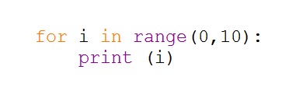
ITERATING through ARRAYS
In earlier lessons you learned how to create counter controlled loops
We can use the same technique to loop through an array/list – using i (or any other counter name) to identify the index number of the array element

Slide 21
Try This
Type the following into Python and run it
You might also want to run your code through Python Tutor to see what’s happening on each iteration ( http://pythontutor.com/ )

Slide 22
Confusing stuff 1!
In AQA pseudocode the first element of an array is always at index position 1 and not 0
animals ← [“Dog”, “Cat”] OUTPUT animals[1]
If you translate this into Python code what does it print out? What is the AQA pseudocode telling you to print out?

Slide 23
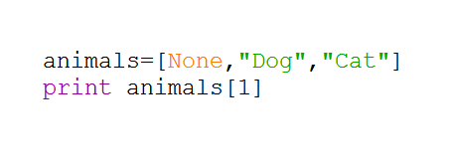
workaround
We can workaround the previous problem in Python by creating a “dummy” first element at index position 0
Python has a special None type that contains no value we can use for the dummy. This can then be ignored in our array operations.
animals ← [“Dog”, “Cat”] OUTPUT animals[1]

Slide 24
Confusing stuff 2!
In many programming languages you must declare an array and specify the number of elements it contains either when declaring it or initialising it.
Once initialised the size of the array (the number of elements it contains) cannot change – arrays are said to be static data structures
However Python lists are dynamic data structures that can shrink or expand. We’ve seen myList.append(new element) adds an extra element to our list and increases its size

Slide 25
WORKAROUND
This array specified by AQA pseudocode has been initialised with 3 strings.
animals ← [“Dog”, “Cat”, “Goldfish”]
This pseudocode could be used to achieve the same thing (assuming we have declared an array called animals)
FOR i ← 1 to 3
animal[i] ← USERINPUT
ENDFOR

Slide 26
PROBLEM
The first piece of pseudocode can be translated (almost) directly into Python
The second piece of pseudocode throws an error if we try a direct translation. Why?

Slide 27
Good practice*
Although Python lists don’t need to be initialised you should mimic declaring and initialising your list so that it corresponds as closely as possible to AQA pseudocode for an array
If the “array” is going to contain strings fill it with empty strings. For a number based array (ints, floats etc.) fill it with zeroes. Don’t forget the dummy None at index 0

Slide 28
PARTY LIST 2
Recap that in our first exercise we needed 5 lines of code to create our list of party guests
Write a new program that:
Creates an “array”called partyList to hold our (5) guest names
Uses a count controlled loop to ask the user 5 times to enter the name of a party guest
Adds each guest to the partyList
You should be able to do this this in 4 lines of code – most importantly it doesn’t matter if we have 5, 50 or 500 (if you’re as popular as me!) guests it still only takes 4 lines of coding to input and store the data

Slide 29
Pseudocode solution
partyList ← [ “”, “”, “”, “”, “”] FOR i ← 1 to 5
OUTPUT “Who would you like to invite?”
partyList[i] ← USERINPUT
ENDFOR

Slide 30
Party LIST 3
Recap that in our first exercise we needed 5 lines of code to output our list of party guests
Extend the program from the previous slide so that:
A count controlled loop iterates through partyList and outputs each guests name
You should be able to do this this in 2 lines of code – most importantly it doesn’t matter if we have 5, 50 or 5000 (if you’re as popular as me!) it still only takes 2 lines of coding to input and store the data

Slide 31
Pseudocode solution
Including the previous solution
partyList ← [ “”, “”, “”, “”, “”] FOR i ← 1 to 5
OUTPUT “Who would you like to invite?”
partyList[i] ← USERINPUT
ENDFOR
FOR i ← 1 to 5
OUTPUT partyList[i]
ENDFOR
Don’t forget that in Python the array initialisation would be:
partyList=[None, “”, “”, “”, “”, “”]

Slide 32
EXTENSION
Your current program only works for 5 party guests
Improve the program so that it works for any number of guests (as defined by the user)

Slide 33
TASK
Write the Python program from the pseudocode code below
classSize ← 7
boys ← 0
girls ← 0
myClass ← [“B”, “G”, “G”, “B”, “G”, “B”, “G”]
FOR i ← 1 to classSize
IF myClass[i] == “G”
girls ← girls + 1
ELSE
boys ← boys + 1
ENDIF
ENDFOR
OUTPUT “Total girls” + girls
OUTPUT “Total boys” + boys

Slide 34
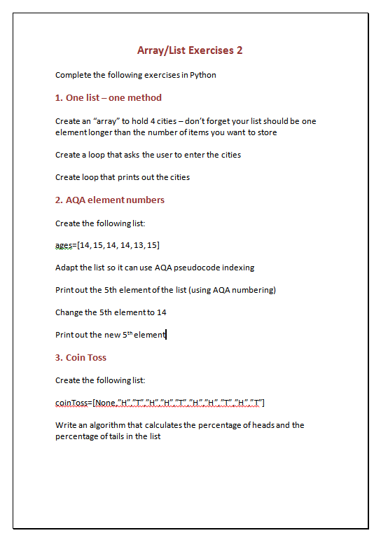
TASK
Load the document arrays2.docx and complete the 3 practical exercises

Slide 35
SUMMARY
A data structure is a collection of different data elements, which are stored together in a structured form
Using data structures can make coding a solution to a problem simpler and more efficient
An array, which is one type of data structure, is a group of elements of the same data type e.g. an array of strings
Elements of the array can be accessed by reference to their index number (starting at 0 in Python but 1 in AQA pseudocode) e.g. cities[4]

Slide 36
SELF EVALUATION
Can you define/describe the following:
Data structure ☹ ☺
Arrays ☹ ☺
Why arrays are useful ☹ ☺
Array elements ☹ ☺
Index numbers ☹ ☺
How AQA array indexes differ from Python ☹ ☺
Now check your skills
I can create an “array” in Python* * Really a list | ☹ 😐 ☺
I can access elements of an array through their index number | ☹ 😐 ☺
I can program a loop that iterates through an array | ☹ 😐 ☺
I can create an array in Python from AQA pseudo code | ☹ 😐 ☺

Slide 37
FURTHER READING/REVISION
http://www.teach-ict.com/gcse_computing/ocr/216_programming/handling_data/miniweb/pg10.htm
http://www.bbc.co.uk/education/guides/z4tf9j6/revision/1
http://www.tutorialspoint.com/python/python_lists.htm
http://learnpythonthehardway.org/book/ex32.html

