Slide 1
Software Development Life Cycle
Key Revision Points

Slide 2
Context
Software development is a complex and expensive process that needs to be managed
It is also important that the solution a programmer develops meets the needs of the client
To keep control over the software life cycle developers use models
The model tells you:
Where you are up to in the process
What needs to happen next

Slide 3
3 Models
There are 3 established life cycle models:
Waterfall
Cyclical
Spiral

Slide 4
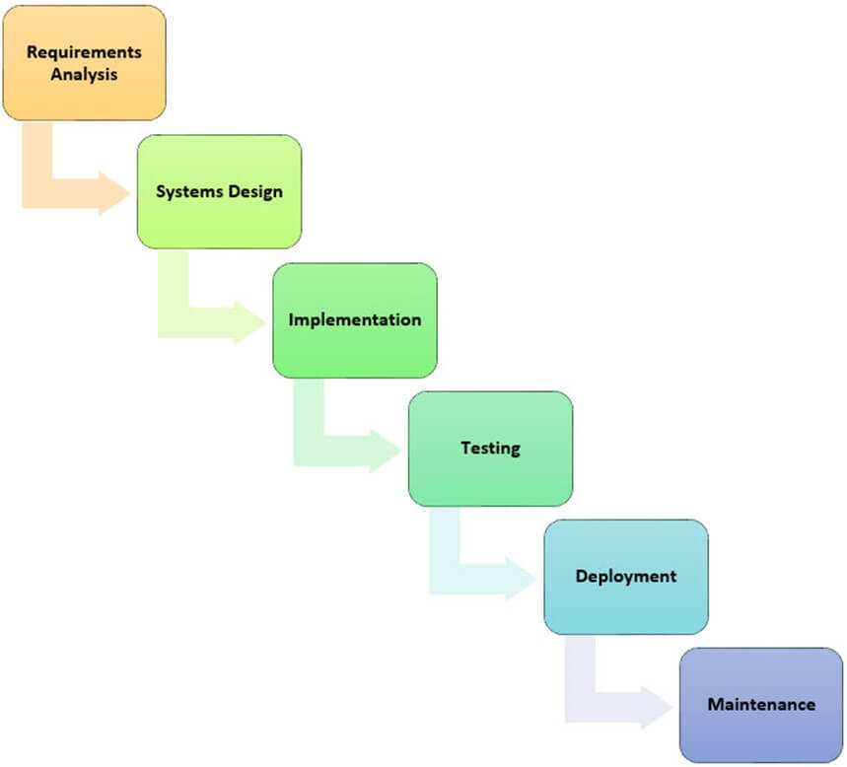
Waterfall Model
The steps are described on next slide

Slide 5
Waterfall Model
Analysis – The development team establishes exactly what is needed from the new software. This is set out in a requirements specification
Design – The requirements may be broken down into chunks (subroutines) and algorithms are designed using flowcharts and pseudocode
Implementation – Programmers take the design brief and write code to match the design
Testing – Programmers test the code to remove all errors
Deployment – The software is installed on computer systems and used by clients
Maintenance – Finally, the software must be maintained. This may include upgrades to improve the software or patches to fix any bugs that come to light after deployment.
LEARN THESE STEPS AS THEY APPLY TO ALL 3 MODELS!!!

Slide 6
Waterfall +/-
Benefits
A straightforward model that is easy to understand
Developers know exactly where they are in the process
Drawbacks
Too rigid – if a problem is discovered at the testing stage the implementation stage must begin again
In real life the stages could overlap – testing one part of the program can begin before another part is designed/implemented – think CA2 vs CA1. Modern programs most likely to be a set of modules each at a different stage of the model – especially true of modern software which is modular in design.

Slide 7
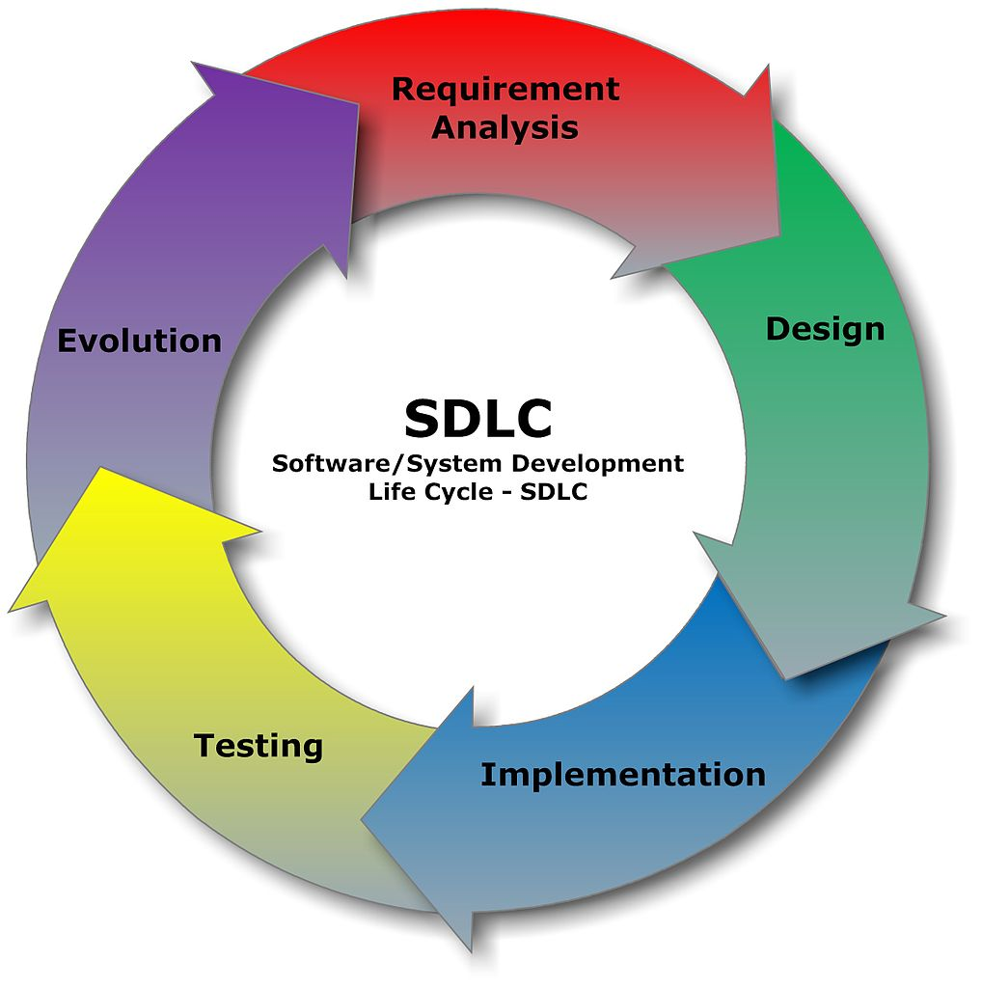
Cyclical Model
Similar stages to the waterfall model but emphasises the need for continuous evaluation and evolution after the system has been deployed

Slide 8
Cyclical +/-
Benefits
Like the waterfall model it is easy to understand
Improvement on the waterfall model as it emphasises the constant need to improve software
Drawbacks
Same as the waterfall model

Slide 9
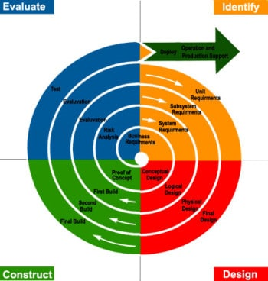
Spiral
Similar to previous models but developers start with a prototype (see slide xx)
With feedback from the end-user the solution is developed at each iteration of the spiral until the software is finally ready for release

Slide 10
Spiral +/-
Benefits
More flexible than the previous two models
More opportunity for design and coding at each iteration
Drawbacks
This model is slow and expensive to follow
Complicated to understand where you are in the process

Slide 11
Prototyping/RAD
RAD (Rapid Application Development) is a model that emphasises developing an early working version of the software
It might include the full user interface but only some of the functionality (Think menu system in CA1/CA2)
Designed to show how the program will work
While the software is still “in-house” the client provides feedback on the early prototypes and the programmer makes necessary changes

Slide 12
Prototyping/RAD
Once tested in-house the client will start using the software as normal
The programming team remain available (for a pre-defined timescale) for corrective maintenance (bug fixing) or improvements
This last step is called the cutover phase

Slide 13
Prototyping +/-
Benefits
Gets software in place as quickly as possible
Will detect bugs/errors earlier than other models
Programmer benefits from real life feedback early in the development process. Final code will more closely match the needs of the user
Drawbacks
Can be time consuming if lots of changes needed to the prototype
Final code may be difficult to maintain or may be lower quality than a properly analysed solution

