Slide 1
Computer Systems
Key Revision Points

Slide 2
Definitions
A combination of hardware and software working together (to accomplish a task or solve a problem).
Hardware refers to the physical components that make up a computer system. These can be installed inside, or connected to the outside, of a computer.
Software describes the programs that control and make use of the hardware. Software is used to give instructions to the processor so that we can accomplish different tasks.

Slide 3
Computer Systems Simplified
INPUT
PROCESSING
OUTPUT
STORAGE

Slide 4
Computer Systems Simplified
DATA
PROCESSING
INFORMATION

Slide 5
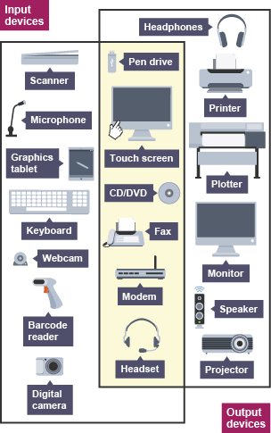
Input & Output Devices
Used to get data into or information out of a computer system
Some devices perform both functions
What about a mobile phone? List the input/output devices built into your phone

Slide 6
Embedded Computer
Many common household and industrial devices have a special purpose computer built into them (often on a single circuit board or chip) called embedded computers or embedded systems

Slide 7
Robust & Reliable
Software in computer systems needs to be robust and reliable. In some cases this is critical e.g. life support systems:
Robust – can cope with a wide range of inputs without crashing.
Reliable – Always behaves in a way that is predicable so can be used with confidence.

Slide 8
Error Trapping
Many problems with non robust and unreliable systems caused during input:
Wrong data type
Data out of range
“Fat fingers”!!!
Some errors can be prevented by the programmer using error trapping techniques (programming defensively) – see next slide

Slide 9
Validation & Verification
Validation – check input for errors using “rules” in the program e.g. while input!=“a”, print error, get input again
Verification – double check data input to make sure it doesn’t contain errors. A common way to do this is by forcing the user to enter the data twice and comparing the two inputs.

