Slide 1
Task 2: Research around Shakespeare’s Richard III 1. The Wars of The Roses 2. Richard III

Slide 2
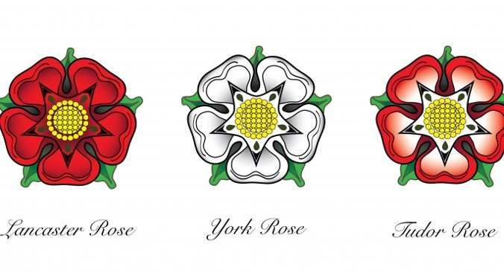
Research 1: The Wars of The Roses, the historic backdrop of our play
The Wars of the Roses were fought in the Fifteenth Century between two branches of the same family, over who had the right to reign in England.
The royal family at the time were the Plantagenets. The warring factions were both members of this extended family : Yorkists and Lancastrians. In 1485, Henry VII was crowned as the first Tudor King, bringing to an end The Plantagenet period and the Wars of the Roses.
Task: Find out five interesting facts (each) about Henry VI, Edward IV and Henry VII.

Slide 3
Research 2: Shakespeare’s characterisation of Richard III
Shakespeare based his drama on real history, but the play is a dramatic representation of events rather than accurate history.
Use the following links to explore some of the myths and realities about Richard III.
https://www.rsc.org.uk/richard-iii/
https://www.bbc.co.uk/cbbc/watch/horrible-histories-richard-iii-song
https://www.historyhit.com/facts-about-king-richard-iii/
http://www.richardiii.net/aboutus.php#origins
Task: Create a mind map, showing a range of positive and negative views of Richard III

