Slide 2
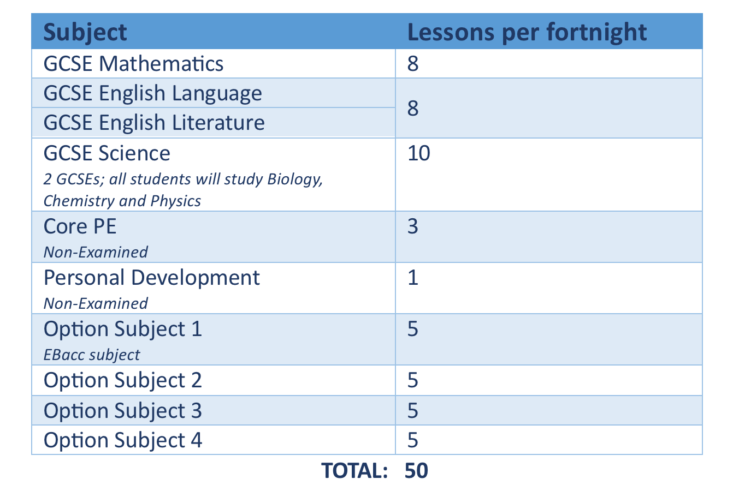
What will you study?
Typically, students in Year 10 and Year 11 study for 9 qualifications.

Slide 4
What is the Ebacc?
To meet the EBacc, a student must study GCSEs in the following areas:
Mathematics
English Language and English Literature
Science – either Combined Science or Triple Science
Geography or History
A Language
They will also need to achieve at least a grade 4 in each of these subjects.

Slide 5
⁺ If a student chooses GCSE Triple Science, this will be instead of GCSE Combined Science

Slide 6
Students must choose 4 subjects in total from the middle and final columns.
All students must choose at least one Ebacc subject from the middle column, but they can choose up to 4.

Slide 7
What are the different qualifications?
GCSE
Most popular
Linear – all exams sat and assessments submitted at end of Year 11
Some have NEAs
Grades 1 to 9
Combine subject theory with practical learning
Focus on work-related skills
Assessment is ongoing throughout the course
Grades L1P to L2D* - an L2P is equivalent to a GCSE grade 4 and a L2D* is equivalent to a GCSE grade 8
BTEC
Very similar approach to BTEC, but different exam board
60% of the course is assessed through NEAs and 40% is assessed via external assessment
The Cambridge Nationals use the same grading system as the BTEC courses
Cambridge Nationals

Slide 8
What are NEAs?
Non-Examination Assessments
Previously known as coursework
All BTEC and Cambridge Nationals have a NEA component
The GCSE courses with a * have a NEA component
Many NEAs have a deadline at the same time, towards the end of Year 11
To avoid too much pressure at this time, carefully consider the number of NEA subjects you choose

Slide 9
Are there any combinations of subjects not allowed?
Due to the overlap between certain subjects and to ensure a broad and balanced set of qualifications, you can only choose one subject from the clusters shown below:
In addition to this, you can only choose:
GCSE French, GCSE German or GCSE Spanish if you study this subject in Year 9
GCSE Music if you play a musical instrument (this can include voice)
GCSE PE if you play a sport for a school team or at club, county or country level

Slide 10
The Dos and Don’ts when making your course choices
Do choose a subject because…
You’ve done your research and…
you think it sounds interesting
it fits with your future aspirations
you think you’ll do well in it – use your Assessment Certificate for guidance
the style of learning and assessment suits you
You’ve spoken to your teachers and they think you’ll do well in it.

Slide 11
The Dos and Don’ts when making your course choices
Don’t choose a subject just because…
Your friends are doing it – this isn’t a good enough reason and you might not even end up in the same class!
You like the teacher – at this stage, we can’t guarantee which teacher you’ll have
Your parents want you to do it - but do listen carefully to what they’re saying, as I’m sure they’ll have some good advice!
It sounds “fun” - all Key Stage 4 courses require a level of hard work if you’re going to do well in them.

Slide 12
Key Stage 4 Course Choices Timeline
Fortnight beginning Mon 20 Jan 2025 | Taster lessons for each option subject to be taught to Year 9 classes
Tue 21 Jan 2025 | Key Stage 4 Course Choices launch for Year 9 students
Thu 30 Jan 2025 | Year 9 Assessment Certificate issued to parents and carers via email
Thu 30 Jan 2025 | Key Stage 4 Course Choices Evening
Fri 31 Jan 2025 | Booking for Year 9 Parents’ Evening opens
Thu 6 Feb 2025 | Year 9 Parents’ Evening
Fri 14 Feb 2025 | Deadline for Key Stage 4 Course Choices application forms

Slide 13
Parents’ Evening
Booking will open tomorrow, Friday 31 January at 7.30pm
We will send a reminder email and information on how to book appointments at 4.30pm tomorrow
Book appointments with your child’s English, Maths and Science teachers
Book appointments with the subjects your child is considering choosing at Key Stage 4

Slide 14
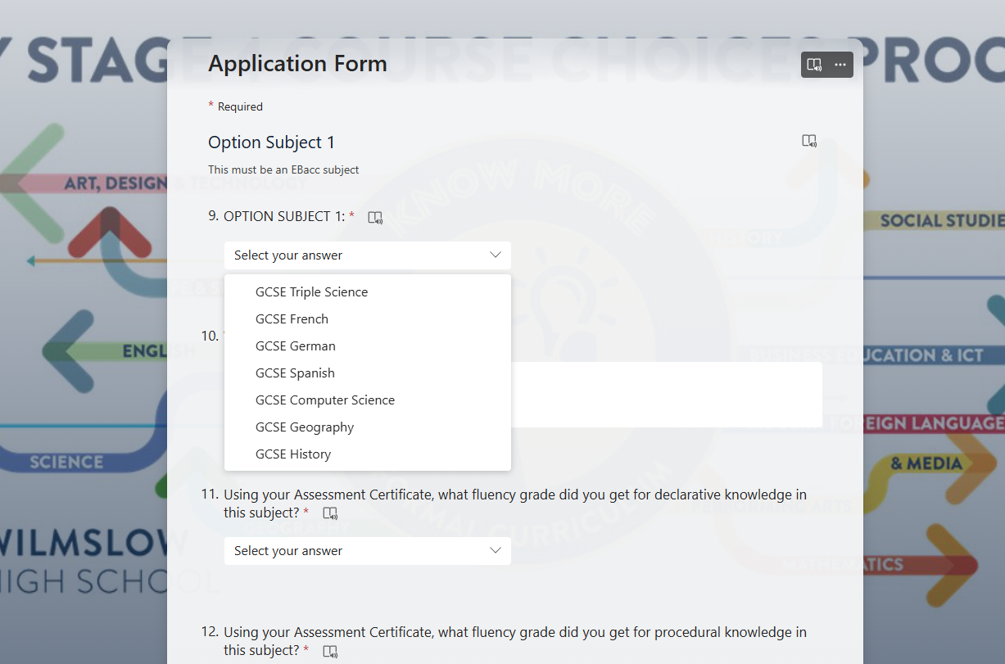
Application Form
Deadline: Friday 14 February

Slide 15
Can I change my mind?
Yes. But there is a big but…
You won’t have as much choice as you do now, due to subject clashes and classes being full
If you change in September, you might miss the start of the course
Therefore, it’s important to do your research at this initial stage and to try and avoid any future changes. This will ensure that a student has their optimal timetable and doesn’t need to make any compromises on their chosen courses further down the line.

Slide 16
Finally…
Throughout this process, we strongly encourage you to speak to your parents, Form Tutors and subject teachers about your course choices for guidance. Your Heads of House, Progress Lead, Named People and myself are also available for further conversations if needed.
And importantly, don’t worry! We’re all here to help and support you through this process.

Slide 17
You can find all of the information from this presentation - and more! - on the Key Stage 4 Course Choices page on Firefly:
Resources > Formal Curriculum > KS4 Course Choices
cgeorge@wilmslowhigh.com

