Slide 1
LEARNING OBJECTIVES
To be introduced to Britain at the turn of the Twentieth century

Slide 2
BRITAIN AT THE TURN OF THE TWENTIETH CENTURY
SIDE 1
EARLY 20th CENTURY BRITAIN
social
economic
SIDE 2
Empire/ Wars
EARLY 20TH CENTURY
POLITICAL BRITAIN
Voting
Laws
Key figures

Slide 3
TASK
You have been given a fact sheet about Britain in 1900.
Add your facts to the right place on your mind-map/ notes/ table.
Then add information from slides 4-14 to your notes.

Slide 4
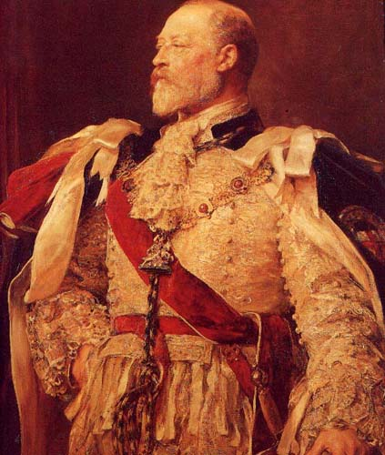
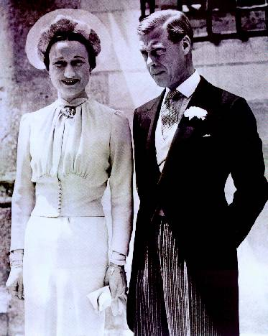
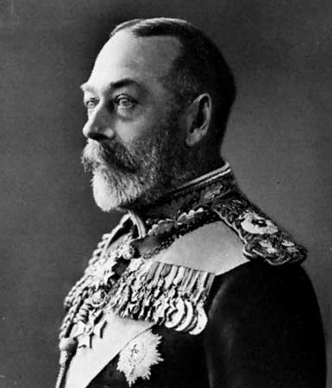
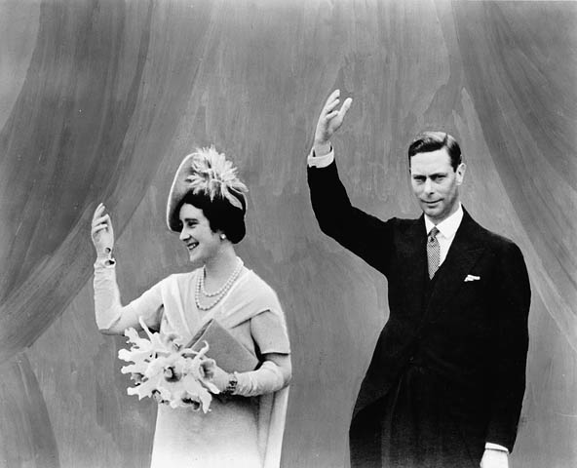
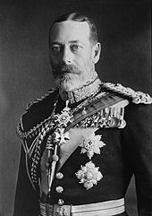
The belief in the monarchy remained a strong feature of British life throughout the period but it was rocked by Edward VIII’s shock abdication in 1936 so that he could marry a married, American lady named Wallis Simpson.
Monarchy

Slide 5
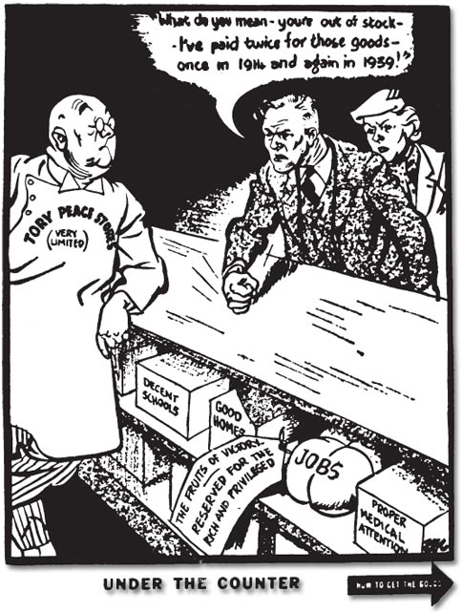
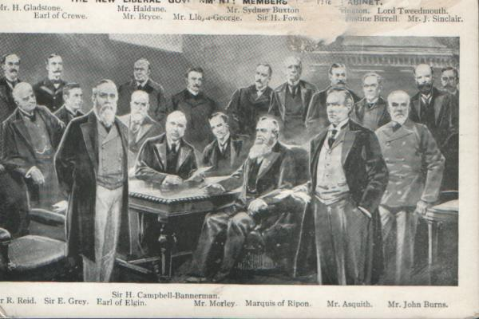
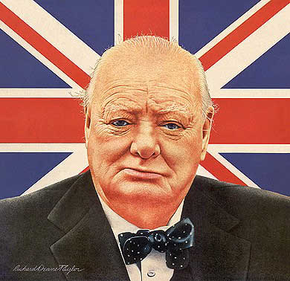
Government
The role of government in people’s lives increased, especially during wartime but also in peacetime in terms of health, housing, education and welfare reforms. Whilst before 1906 the government would most often act in the interests of the army, empire or elites, increasingly their focus was forced towards provision for the people.

Slide 6
Who has the right to vote in elections?
In 1906 only one third of adults
had the right to vote.
By 1951
98% of all adults could vote.
.
Notes:
*

Slide 7
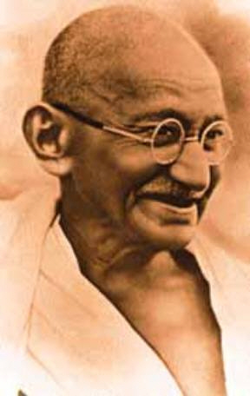
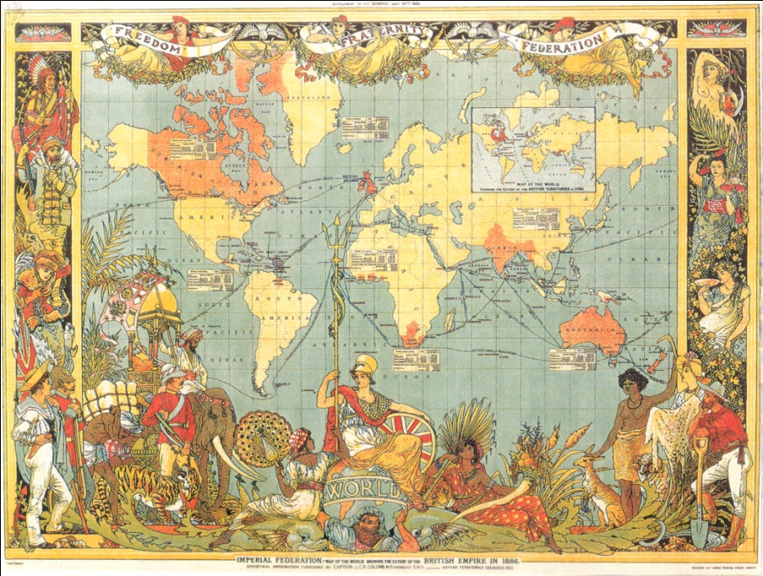
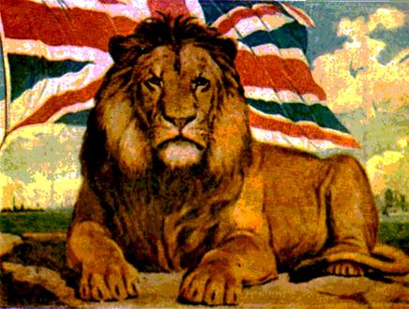
Empire
In 1906 Britain held the biggest empire in the world and still focused on being in ‘splendid isolation’ to the rest of the world.
By the 1950s, Britain had been forced to give up some of its key overseas territories such as India, Ireland, Iraq, Egypt, Malaysia, Singapore, Australia, New Zealand and South Africa!

Slide 8
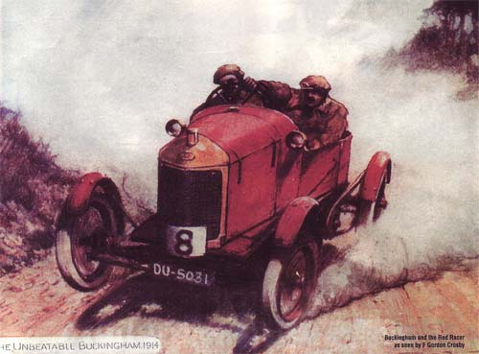
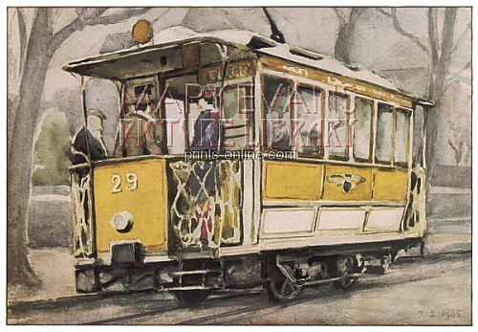
Transport
Only 1 in 10 people owned a car by 1940
Modes of transport increased in number and popularity. Cars had a particular impact on leisure time, although the top speed limit for 20mph! You didn’t even need to pass a driving test until 1934 and you wouldn’t have encountered any traffic lights before the late 1930’s.

Slide 9
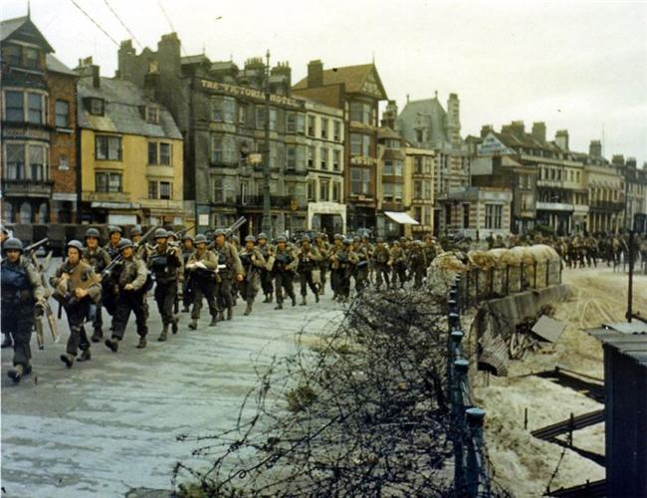
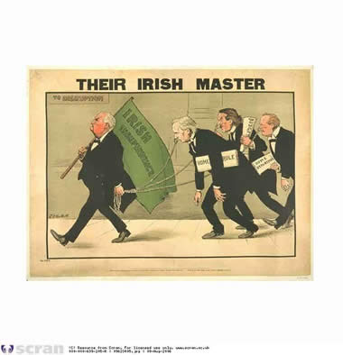
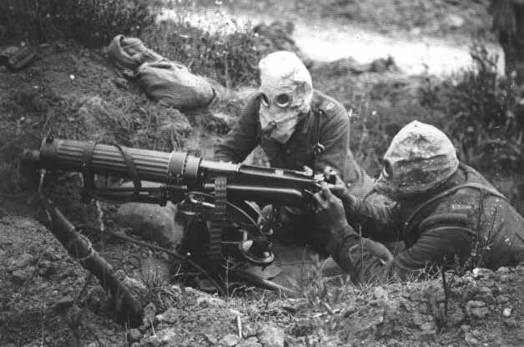
Conflict
The British Government found itself at the centre of many conflicts between 1906 and 1951. Of course, World War One and World War Two but also conflict with Ireland over whether the Ireland should be independent from Britain.

Slide 10
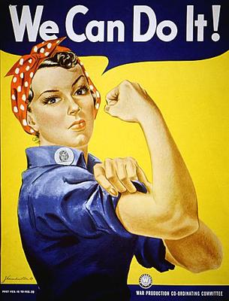
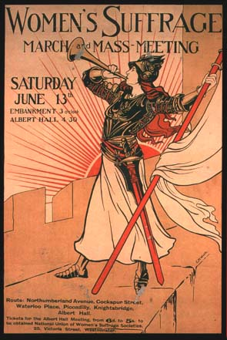
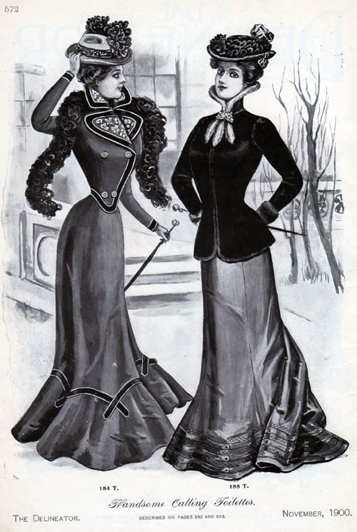
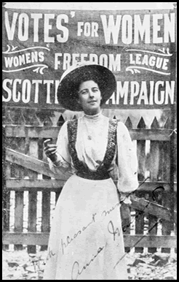
Women
A woman born before 1900 could expect a typical life of domesticity and drudgery. By 1928, women had achieved the vote on equal terms with men and by the 1950s had proved their equal worth through war work – but the campaign to achieve equality took a lot longer.
Women’s fashions caused permanent damage!

Slide 11
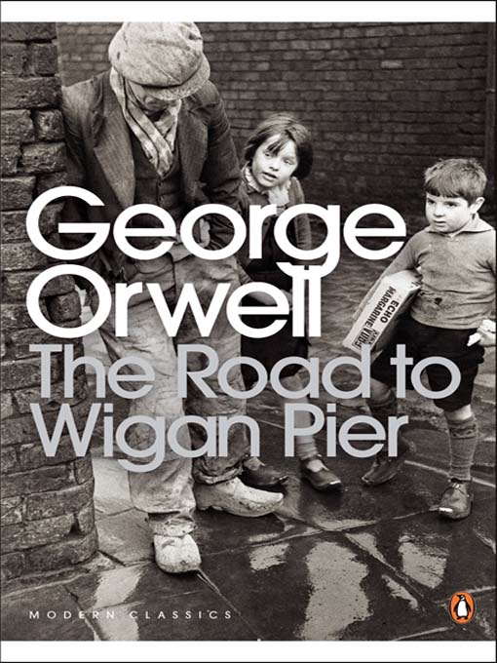
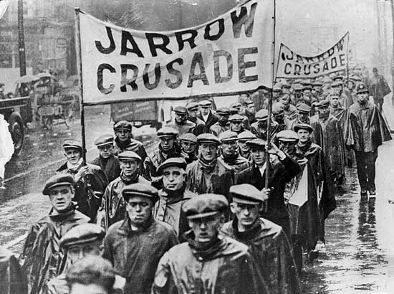
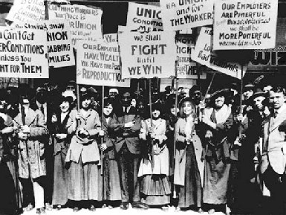
Employment
The rights of workers are a constant theme in this period. In 1900, the conditions that the majority of British people lived in were squalid. Following the Wall Street Crash, a period of depression, hunger and unemployment followed that led to strikes and misery for many working class people. The government was often criticised for doing too little and too late to address these issues – not much as changed then!

Slide 12
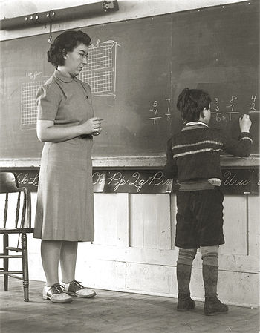
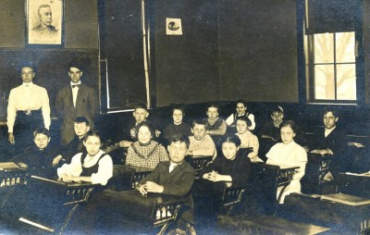
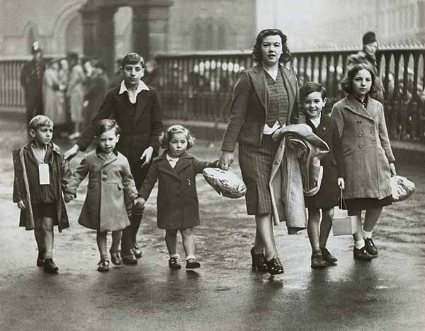
Education
Governments started to take education for all more seriously, before 1915 only rich children really benefitted from education. By 1944, Butler’s Education Act had established the principle of free education for all but still quotas for girls continued – if these had no been in place over 2/3 of grammar school places would have gone to girls and this was seen as unacceptable!

Slide 13
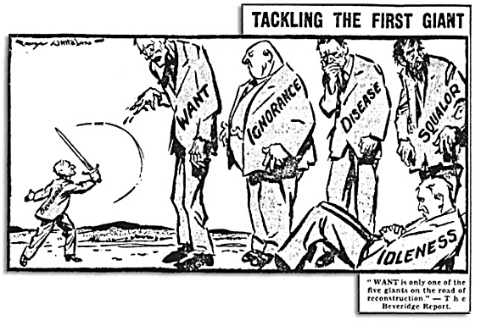
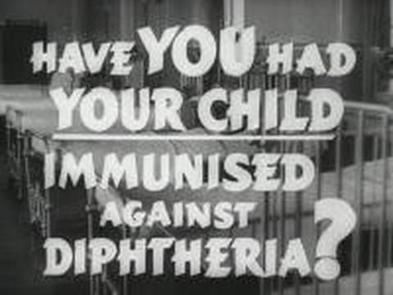
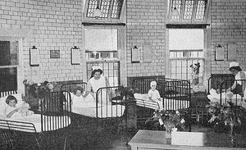
Whilst in 1900, British people suffered from disease, poverty and poor living standards, by 1950 the government had taken active steps to improve the health of the nation through the introduction of the Welfare State and the NHS.
Health

Slide 14
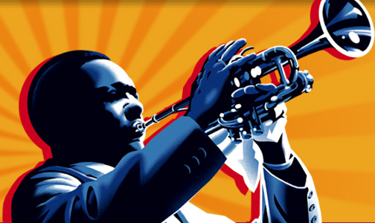
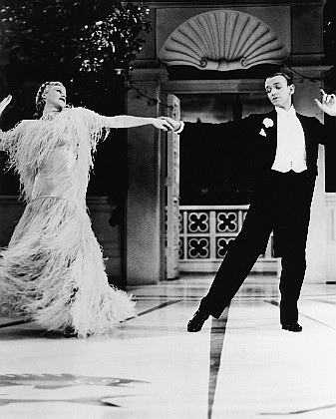
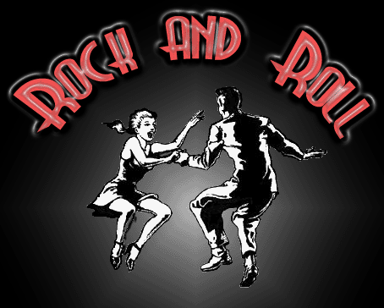
Entertainment
The early 20th century saw an explosion in entertainment
NB: Most people in Britain could not afford TV’s and Jazz clubs but the cinema was very cheap. 100 millions tickets were sold every week in 1920’s Britain.

