Slide 1
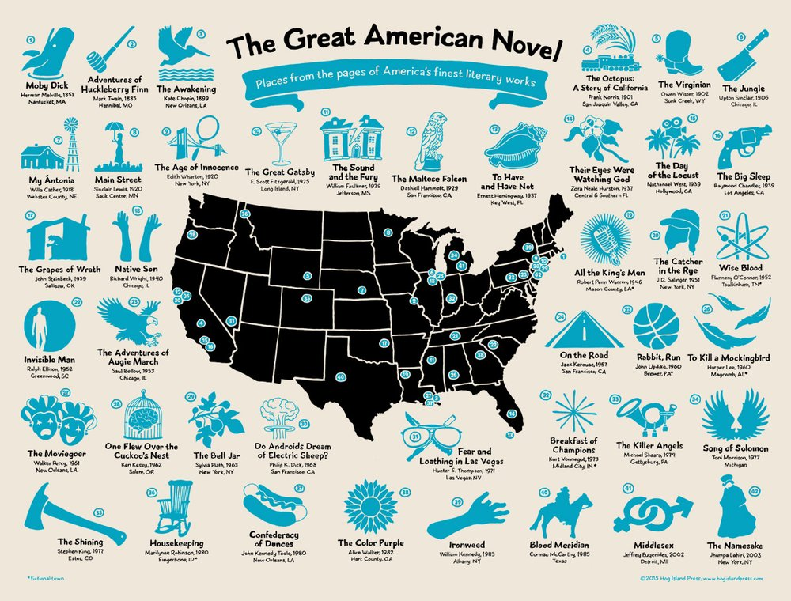
Task 3: Wider Reading: American Literature As part of your preparation for the American Fiction unit, research and choose an American novel to read over the summer. Your notes need to be completed to hand in to your teacher at the start of term.

Slide 2
Wider Reading: To prepare for Paper 2: American Literature 1880-1940
Task: Response to Classic American Fiction
Choose one text written from the list on the next slide. Read the novel and use the headings below to record your responses and ideas.
Many are very cheap to buy (some of the older texts are free via a Kindle/tablet)
E Platform: Borrow e books and audio books from LRC: To log on through the Reading School tab use your g-number as username and usual password (the one used to log on to school computers)
Amazon.co.uk and goodreads.com has customer reviews for individual novels which might help you to choose
Task Details: one side of A4 with notes on the following:
Social and historic context: When and where in the USA is the book set? What was American society like at this time?
Themes and characters: What do you think are the main ideas explored in this novel? Who are the main characters? How do you respond to them?
Your response: Did you enjoy the novel? Did it present any challenges?

Slide 3
Wider Reading: Classic American Literature
Nathaniel Hawthorne: The Scarlet Letter (1850)
Herman Melville: Moby Dick (1851)
Harriet Beecher Stowe: Uncle Tom's Cabin (1852)
Louisa May Alcott Little Women (1868)
Henry James: The Portrait of a Lady (1881)
Mark Twain: Adventures of Huckleberry Finn (1884)
Charlotte Perkins Gilman The Yellow Wallpaper(1892)
Stephen Crane The Red Badge of Courage (1895)
Kate Chopin The Awakening (1899)
Theodore Dreiser: Sister Carrie (1900)
Jack London: The Call of the Wild (1903)
Edith Wharton: House of Mirth (1905)/Ethan Frome (1911)/ The Age of Innocence (1920)
Upton Sinclair: The Jungle (1906)
Willa Cather: My Ántonia (1918)
Ernest Hemingway: The Sun Also Rises(1926)/ A Farewell to Arms (1929)
F Scott Fitzgerald: Tender is the Night (1934)
Margaret Mitchell Gone with the Wind (1936)
Zora Neale Hurston: Their Eyes Were Watching God (1937)
John Steinbeck: The Grapes of Wrath (1939)
Carson McCullers The Heart is a Lonely Hunter (1940)
There is a wide range of books on this list. Before you choose, you will need to research the different authors and books and select a text that you think you’ll enjoy.

