Slide 1
Networks 1
Key Revision Points

Slide 2
Key Points to Learn
Key Terms
3 differences between a LAN and a WAN
Advantages/Disadvantages of a LAN vs. stand-alone computers
Hardware need for a network

Slide 3
Definitions
A computer network is a number of computers linked together to allow them to share resources. Networked computers can share hardware, software and data.
Most computer networks have at least one server. A server is a powerful computer that provides one or more services to a network and its users. For example, file storage and email.
A LAN (Local Area Network) covers a small area such as one site or building, e.g. a school or a college.
A WAN (Wide Area Network) covers a large geographical area. Most WANs are made from several LANs connected together.

Slide 4
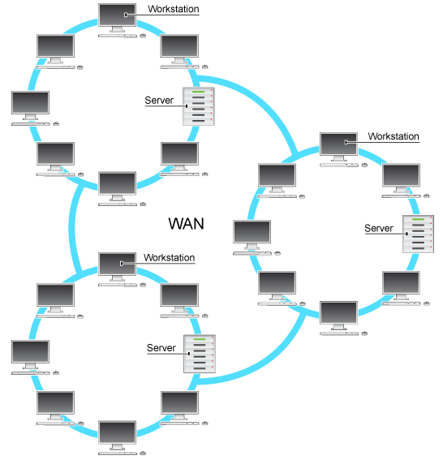
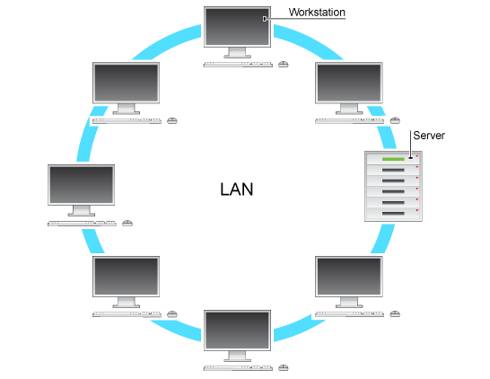
LAN and WAN
Don’t forget that a switch connects devices on a LAN and a router connects LANs to a WAN

Slide 5
Key Differences
LAN | WAN
Small geographical area e.g. a school | Connects LANs in different locations
Hardware owned by the organisation | Organisations hire infrastructure
Connected by ethernet(wired) or wireless | Connected using fibre, copper phone lines or satellite link
Each row is one point on an exam question

Slide 6
Benefits of LAN
Advantages
Sharing devices such as printers saves money.
Files can easily be shared between users.
Network users can communicate by email and instant messenger.
Security is good - users cannot see other users' files unlike on stand-alone machines.
Data is easy to backup as all the data is stored on the file server.

Slide 7
Drawbacks of LAN
Disadvantages
Purchasing the network cabling and file servers can be expensive.
Managing a large network is complicated. A network manager usually needs to be employed.
If the file server breaks down the files on the file server become inaccessible.
There is a danger of hacking, particularly with wide area networks. Security procedures are needed to prevent such abuse, eg. a firewall.

Slide 8
Hardware 1
Each device on a LAN needs a network adapter such as a network interface card (NIC)
Ethernet Cabling is needed in a non-wireless network to connect the computers and peripherals. The most common types are Cat5e and Cat6

Slide 9
Hardware 2
A switch is used to link computers and peripherals together in a cabled network. Switches receive data from one device (in units called frames) and transmit it to another device
A wireless access point (WAP) is a device that allows computers and printers etc. to connect to a wired network using radio waves rather than cabling (it’s basically a wireless switch). Devices connecting to a WAP need wireless capability
A router is required to connect different networks e.g. connect your home network to the Internet

