Slide 1
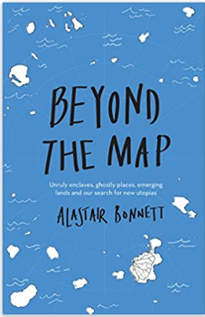
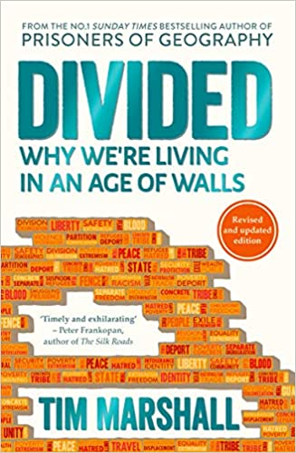
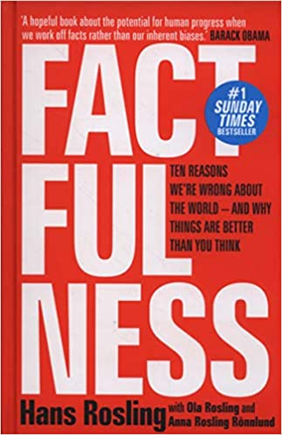
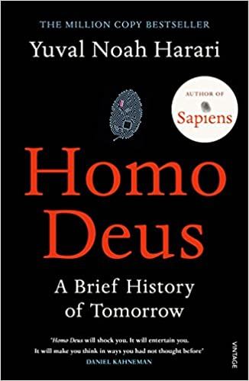
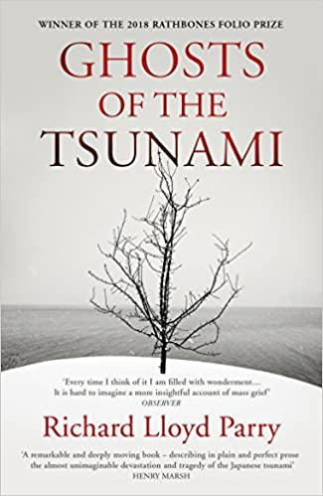
Geography Reading list
Alastair Bonnett uncovers the stories of thirty-nine extraordinary places, each of which challenges us to re-imagine the world around us. From emerging islands, disruptive enclaves and bold utopian visions to uncanny ruins, ghostly tunnels and hidden landscapes – these are destinations that lie beyond ordinary coordinates.
Every story has two sides, and so does every wall. We’re in a new era of tribalism and the barricades are going up. Money, race, religion, politics: these are the things that divide us. Trump’s wall says as much about America’s divided past as it does its future. The Great Firewall of China separates ‘us’ from ‘them’. In Europe, the explosive combination of politics and migration threatens liberal democracy itself.
In Factfulness, Professor of International Health and a man who can make data sing, Hans Rosling, together with his two long-time collaborators Anna and Ola, offers a radical new explanation of why this happens, and reveals the ten instincts that distort our perspective. It turns out that the world, for all its imperfections, is in a much better state than we might think.
Yuval Noah Harari envisions a near future in which we face a new set of challenges. Homo Deus explores the projects, dreams and nightmares that will shape the twenty-first century and beyond – from overcoming death to creating artificial life. It asks the fundamental questions: how can we protect this fragile world from our own destructive power? And what does our future hold?
In August 2018 a fifteen-year-old Swedish girl, Greta Thunberg, decided not to go to school one day. Her actions ended up sparking a global movement for action against the climate crisis, inspiring millions of pupils to go on strike for our planet, forcing governments to listen, and earning her a Nobel Peace Prize nomination. This book brings you Greta in her own words, for the first time. Collecting her speeches that have made history across Europe, from the UN to mass street protests
On 11 March 2011, a massive earthquake sent a 120-foot-high tsunami smashing into the coast of north-east Japan. It was Japan’s greatest single loss of life since the atomic bombing of Nagasaki.Richard Lloyd Parry, an award-winning foreign correspondent, lived through the earthquake in Tokyo, and spent six years reporting from the epicentre. Learning about the lives of those affected through their own personal accounts, he paints a rich picture of the impact the tsunami had on day to day Japanese life.

Slide 2
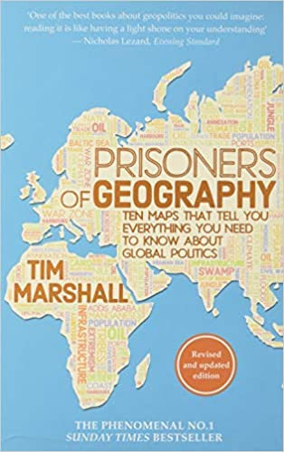
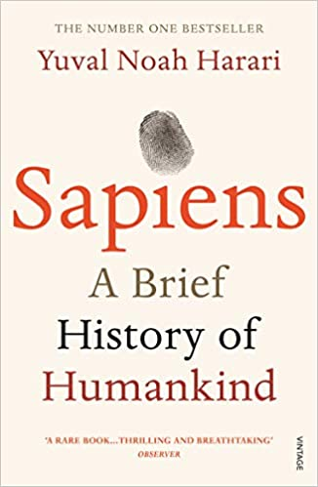
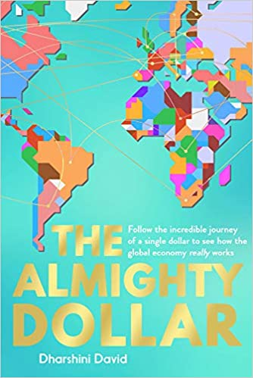
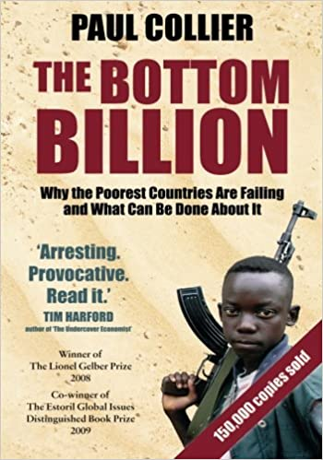
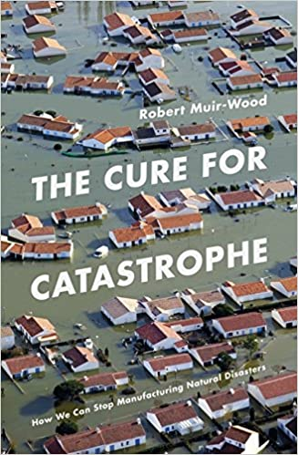
Geography Reading list
All leaders are constrained by geography. Their choices are limited by mountains, rivers, seas and concrete. Yes, to follow world events you need to understand people, ideas and movements - but if you don't know geography, you'll never have the full picture.If you've ever wondered why Putin is so obsessed with Crimea, why the USA was destined to become a global superpower, or why China's power base continues to expand ever outwards, the answers are all here.
Earth is 4.5 billion years old. In just a fraction of that time, one species among countless others has conquered it: us. In this bold and provocative book, Yuval Noah Harari explores who we are, how we got here and where we’re going.
Have you ever wondered why we can afford to buy far more clothes than our grandparents ever could ... but may be less likely to own a home in which to keep them all? Why your petrol bill can double in a matter of months, but it never falls as fast? Behind all of this lies economics.It's not always easy to grasp the complex forces that are shaping our lives. But by following a dollar on its journey around the globe, we can start to piece it all together.
In this elegant and impassioned synthesis from one of the world's leading experts on Africa and poverty, economist Paul Collier writes persuasively that although nearly five billion of the world's people are beginning to climb from desperate poverty and to benefit from globalization's reach to developing countries, there is a "bottom billion" of the world's poor whose countries, largely immune to the forces of global economy, are falling farther behind and are in danger of falling apart, separating permanently and tragically from the rest of the world.
Traversing continents and history, Robert Muir-Wood blends gripping storytelling with scientific insights to detail our efforts to tame the most extreme forces of nature. At the frontlines, the predictive powers of new technologies mean we can foresee a future where there is an end to the pain and destruction wrought by these devastating cataclysms. As The Cure for Catastrophe makes clear, we have an extraordinary opportunity before us – to make the decisions about what we build, where we live and how warnings are communicated that could save millions of lives.

