Slide 1
Testing
Key Revision Points

Slide 2
Testing
The aim of testing is to ensure that a program is robust (doesn’t break) and reliable (produces) expected results. Programmers have two sets of tools:
Built-in programming tools
The test plan

Slide 3
Key Terms to Know
IDE
Debugger
Breakpoint
Watch
Step
Normal data
Erroneous data
Extreme data
Trace table

Slide 4
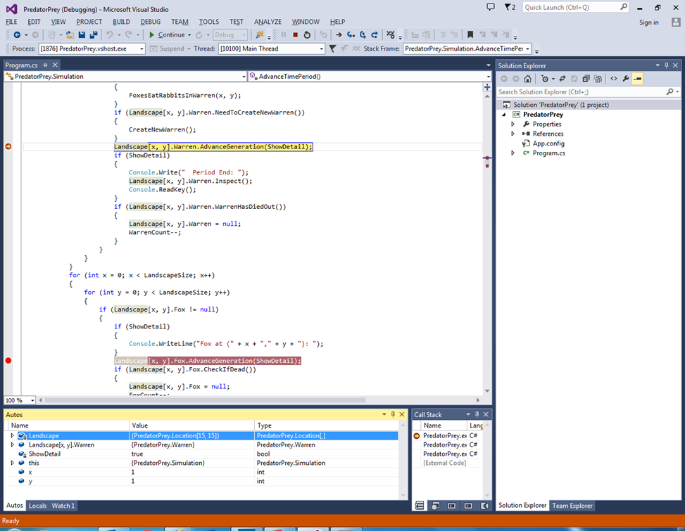
Debugger
The IDE or Integrated Development Environment usually contains a debugger - a number of built-in tools that allow the programmer to debug (find and correct errors) and test programs
These tools are discussed on the next few slides:

Slide 5
Breakpoints
Manually inserted by the programmer
They stop the program at key points so that the content of variables can be inspected or the path through a program traced

Slide 6
Watch
The “watch” window shows the current content of variables as each line of the program is executed

Slide 7
Step
The step tool(s) allows the programmer to run the program line by line so that he/she can trace the path the program takes
At each step he/she can inspect the content of variables in the watch window

Slide 8
Other IDE Tools
Autocomplete of commands and expressions
Avoids syntax errors
Error List
Shows a list of syntax errors that stop a program compiling

Slide 9
Test Plan
A test plan is a manual set of tests drawn up by a programmer to ensure that a programmer works under all circumstances
The program should be tested using 3 types of data:

Slide 10
Test Data
Normal data – data that the program should always work with. Normal data should be accepted by the program
Erroneous data – invalid data that the program should reject
Extreme data – boundary data that the program should accept
See next slide for example

Slide 11
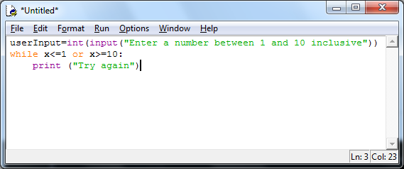
Test Data Example
Test with normal data
6 should be and is accepted
Test with erroneous data
15 should be and is rejected
Test with extreme data
1 and/or 10 should be accepted
Both are rejected
Program has failed test

Slide 12
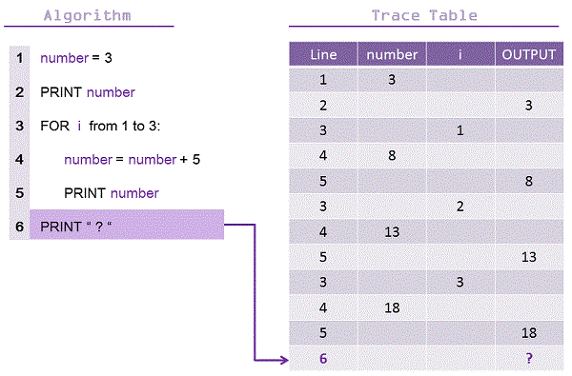
Trace Table
A trace table is a way of manually writing down what you expect the value of each variable to be at each step of a program
This can then be compared with the actual output (in the watch window) to see if the values match

