Slide 1
Databases
Key Revision Points

Slide 2
Database
Used to store large amounts of data
Data organised into tables
Organised collection of data

Slide 3
Key Terms to Know
Database
Field
Record
Primary Key
Flat File
Relational database
Relation
Foreign Key
Redundancy
Index (Indexing)

Slide 4
Field
Contains a single piece of data about a “thing” (person/object)
Name, address, telephone etc.
One field = One column of a database table
Column headings are called field names

Slide 5
Record
All the data about a single/specific item
One record = One row of a database table

Slide 6
Primary Key
All tables should have a primary key field (or just key field)
Field where every record must have a unique value
Often an “artificial number” – your G0 number uniquely identifies you
Don’t use G0 number in exam!!! National Insurance Number, Employee Number, StudentID etc. all OK

Slide 7
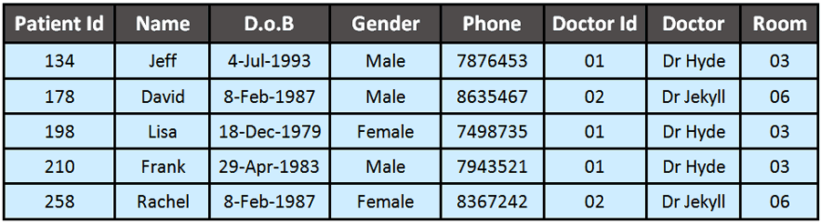
Example
Field names
Primary Key Field
5 Records
8 fields per record

Slide 8
Flat File
A database containing a single table is called a flat file database
Easy to set up
Very inefficient as it may end up storing lots of unnecessarily duplicated data (redundancy)
Example on previous slide is a flat file database

Slide 9
Flat File Problem
Redundant data about doctors
Unnecessary storage
Difficult to update
More chance of data entry errors e.g. misspelling doctor’s name

Slide 10
Relational Database
Sometimes called an RDBMS (Relational Database Management System)
Contains two or more linked tables
The links are called relations

Slide 11
Relations
To link two tables:
The primary key field from one table is included in another table
The field in the second table is called a foreign key

Slide 12
RDBMS Example

Slide 13
RDBMS Benefits
Saves on storage space
Speeds up data entry
Less chance of data entry errors
If a change is needed, it is made in one place only

Slide 14
SQL
Once organised into a database data can be searched/sorted using queries
SQL is the language most commonly used to manipulate databases
See presentation on SQL

Slide 15
Indexes
An index can be added to any one field in a database table
Although the user cannot see it, adding an index makes searching on that field much quicker
A drawback is that adding new data will be slower if a table contains an index
You usually wont see any changes in speed/efficiency until the database contains millions of records

Slide 16
Textbook
Page 52

