Slide 1
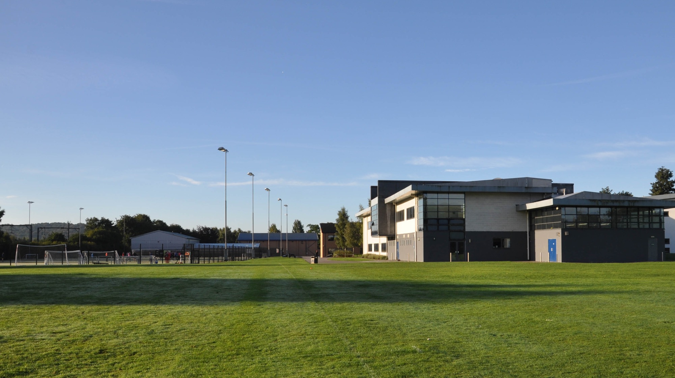
WELCOME TO WILMSLOW HIGH SCHOOL
SIXTH FORM OPPORTUNITIES EVENING
2023

Slide 2
Options?
Wilmslow High School Sixth Form
Local Sixth Form College
Macclesfield College
Cheadle College
Stockport College
Trafford College
Reaseheath College
Manchester Access College
Manchester College
Apprenticeship

Slide 3
Qualifications
A-levels
BTEC
A combination of A-levels and BTECs
Level 2 and 3 BTEC courses
Vocational Courses
T Levels
Apprenticeship

Slide 4
Vocational Courses
Designed of those who like a hands-on practical approach to learning, providing an alternative to A-levels, focusing on one specialist area
Provides work experience, skills and knowledge to progress into a particular industry, Apprenticeship or onto University

Slide 5
Apprenticeships
A full time job –apprentices are employed by a company where they will gain hand-on experience and expertise
The apprentice will also study for a qualification at the same time as working. They may attend a college once a week or may study completely in the workplace
An apprentice earns a salary – the amount earned will depend on the employer
Trades, engineering, health and social care, childcare, business, human resources, hospitality, finance, hair and beauty, science….

Slide 6
T Levels
A new type of qualification which allows you to complete work placements alongside your studies
Students gain a nationally-recognised qualification, as well as UCAS points to apply for university
Equivalent to 3 A-levels – 80% classroom learning, 20% work experience
Construction: Design, Surveying and Planning, Digital: Production Design & Development, Health and Social Care, Education and Childcare, Creative Media, Adult Nursing

Slide 7
BTEC and A-level UCAS Points
A Level Grade | BTEC National Grade | UCAS Points
A* | D* - Distinction* | 56
A | D - Distinction | 48
B | - | 40
C | M - Merit | 32
D | - | 24
E | P - Pass | 16

Slide 8
Wilmslow High School Sixth Form
“THE PURSUIT OF EXCELLENCE
FOR EVERY STUDENT, EVERY DAY.”

Slide 9
WHOLE EDUCATION

Slide 10
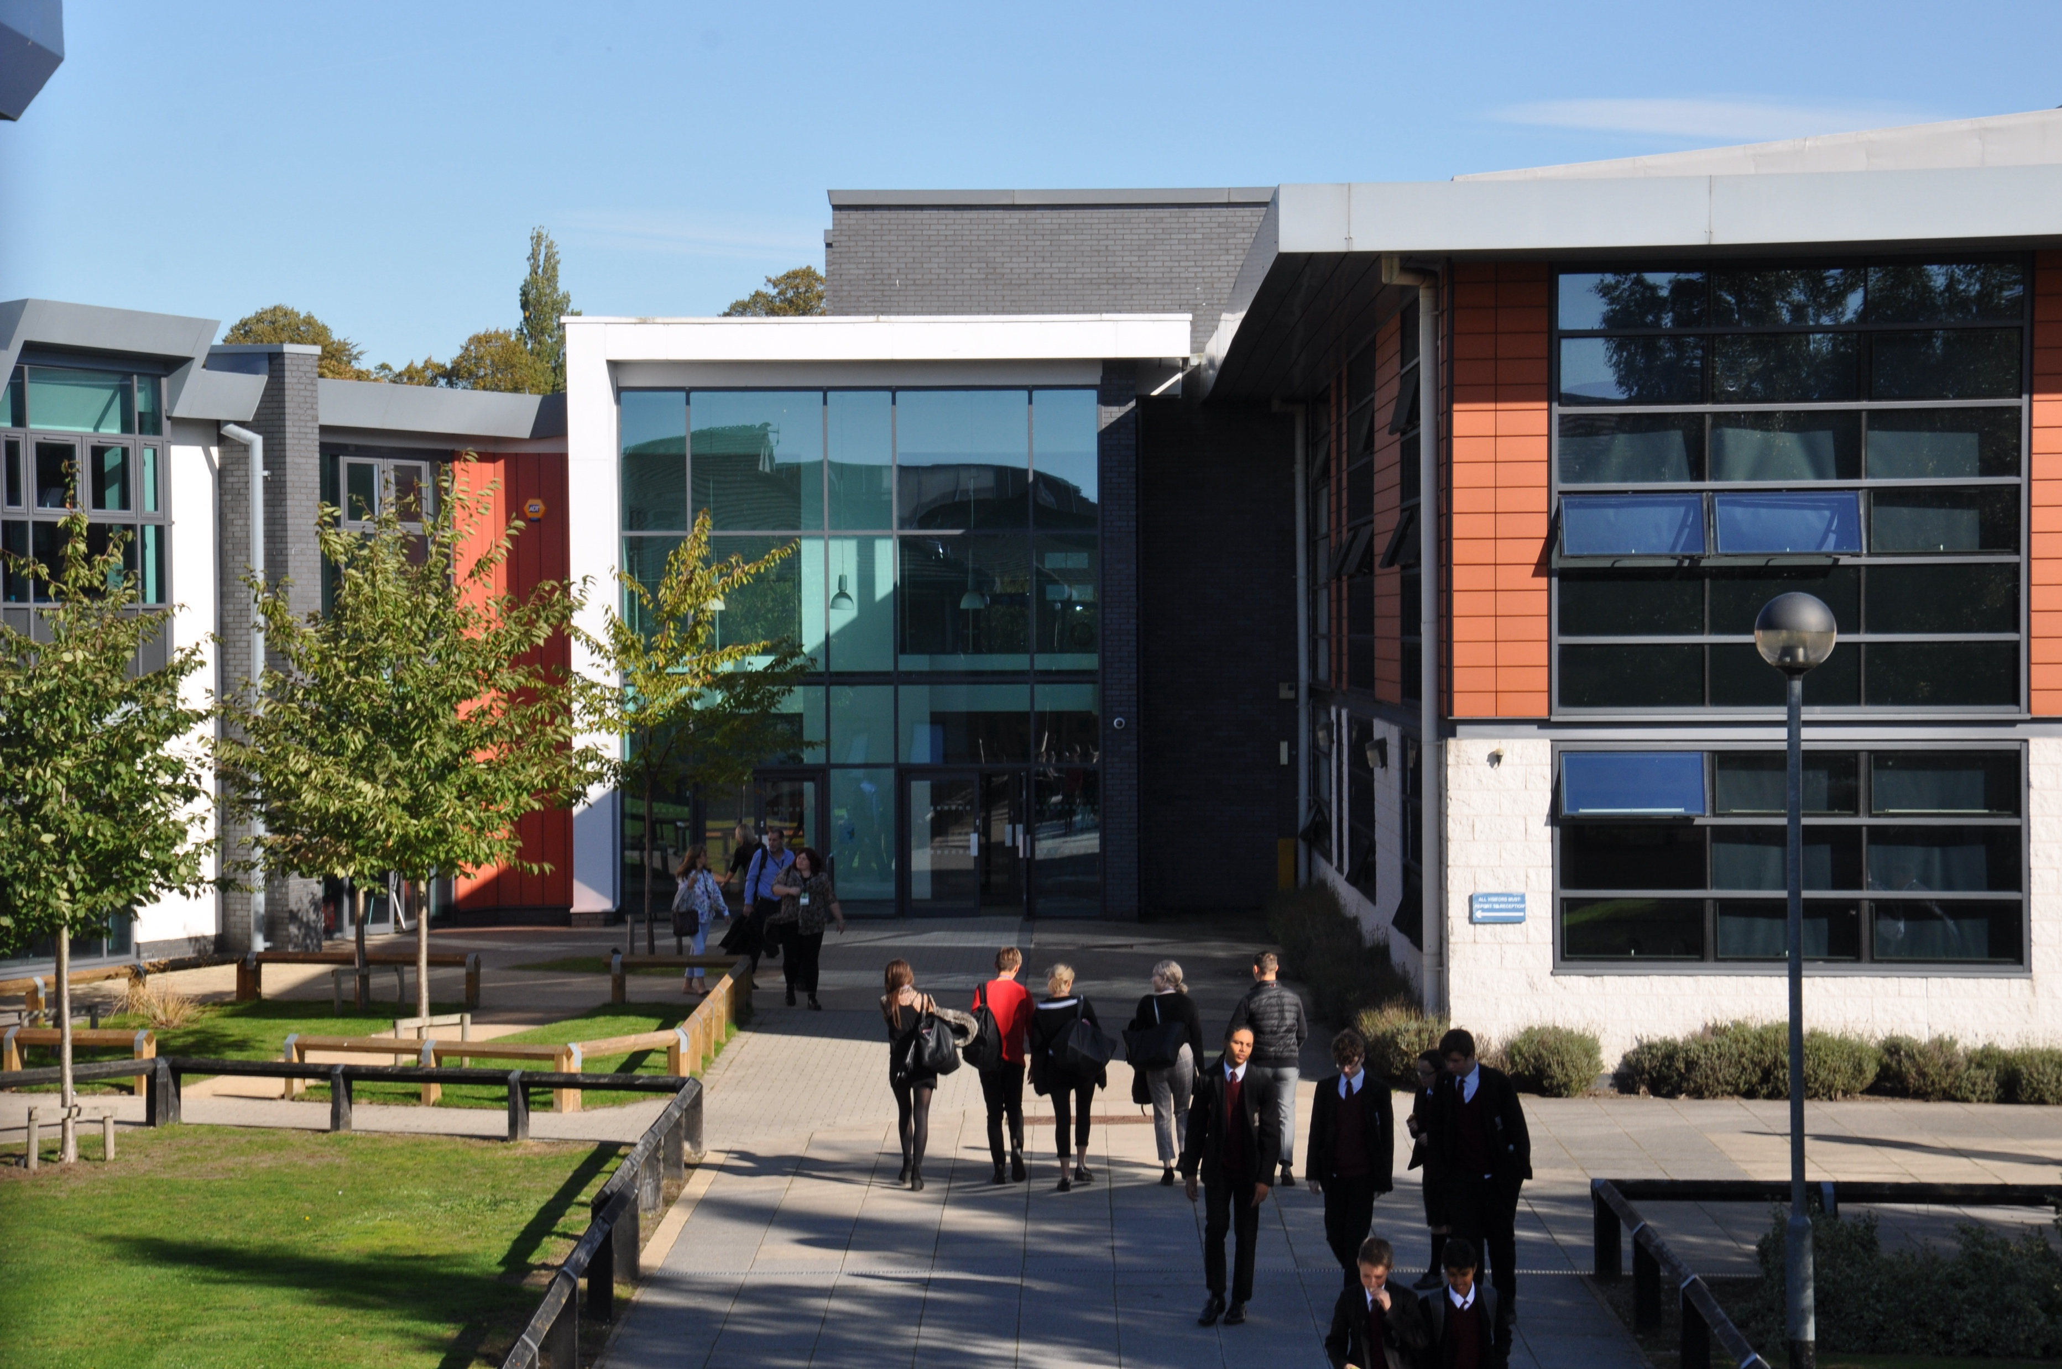
At Wilmslow High School we believe that our Sixth Form students are entitled to a powerful curriculum that enables them to develop the knowledge, skills and qualities needed to flourish in life, learning and work.

Slide 11
The Formal Curriculum
Hours that count towards formal qualifications: 15 periods per week (as a minimum)
A-level/BTEC courses
All courses are 2 year linear courses
A-level external examinations are taken at the end of the 2 years
We are no longer offering AS qualifications over 1 year
BTEC examinations take place at different points during the 2 year course

Slide 12
BTEC Options
BTEC Extended Certificate – Single Option
Enterprise & Entrepreneurship
Information Technology
Law
IT
Sport
BTEC Extended Diploma – Triple Option
Sport

Slide 13
Timetable
15 Lessons, 2 lessons of enrichment
2 Supervised study sessions
1 Wider Curriculum lesson each fortnight
Leadership and Volunteering

Slide 14
Non-Contact Periods
There are no such things as ‘free lessons’
Exam boards recommend 5 hours of individual study for each subject every week (15 hours in total)
The step up from GCSE to A-level/Level 3 BTEC courses is huge
The students who recognise this straight away and make use of their non-contact periods to complete homework, coursework or revise key topics are the students that are generally successful on these courses
All Year 12 students will have at least two compulsory supervised study sessions each week
In some cases we will timetable additional supervised study sessions during students’ non-contact periods to ensure that they keep on top of their work and use their time wisely
Supervised and group study areas

Slide 15
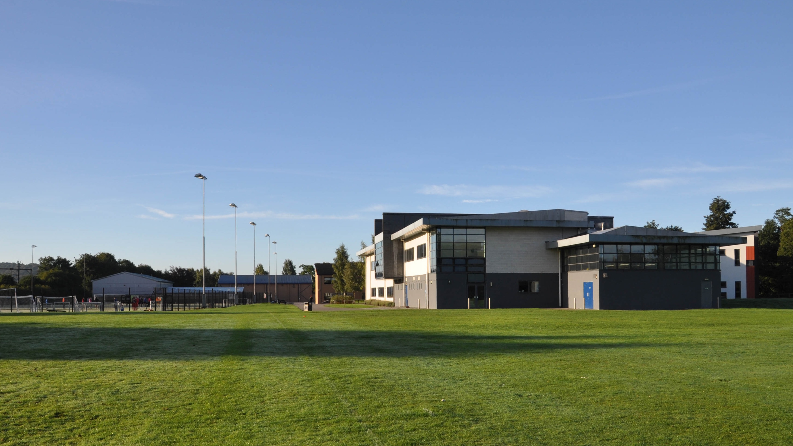
Our Wider Curriculum The experiences and learning that take students beyond the classroom

Slide 16
Wider Curriculum Intent
Our Wider Curriculum seeks to develop well-informed, healthy and caring Young People of Character who will flourish in life, learning and work.
We aim to empower every student to develop the knowledge, skills and understanding to lead safe, happy and fulfilling lives and to make a positive contribution to their community.

Slide 17
Sixth Form Leadership Opportunities
Top 5 skills that employers/Universities look for:
Critical thinking and problem solving
Teamwork and collaboration
Professionalism and strong work ethic
Oral and written communication skills
Leadership
How can students ensure that they make the most of their time at WHS and stand out from the crowd?

Slide 18
Make a difference in the following Wider Curriculum areas

Slide 19
What types of thing can you get involved with?
Leadership and Volunteering
Year 7 Social Action
Year 8 Eco Schools Award
Progress Bases
Reading Mentors
Lesson Support
X-tra Support
Peer Mentoring
Homework Club
Enrichment
Competitive and Social Sport
School Newspaper
EPQ
TEFL
DofE
Bar Mock Trial
Young Enterprise
Performing Arts
Creative Writing

Slide 20
Mrs Cook
Careers Lead and
Head of Post-16 Guidance

Slide 21
What do our sixth form students do next?
Year 13 2023 leavers (207 students):
123 students started in higher education this autumn. More have taken gap years and already have places confirmed or are applying for 2024 entry
22% of the cohort started at Russell Group universities
2 students to Oxbridge and 1 for Veterinary Science

Slide 22
Non-university routes
A growing number of students following apprenticeship and degree apprenticeship routes or are choosing to work full-time.
Examples this year include:
Royal London
The Hut Group
Rymans
Thales
Azetz
Barclays
S and G Response
Together Finance
Wilmslow Leisure Centre

Slide 23
How do we help students to make the right choices about their post-18 futures?
Use of online platform Unifrog and connected activities
Form tutor guidance
University speakers
Apprenticeship speakers
Support from The Pledge, including Employment Readiness Programme for non-UCAS students
Alumni
WHS guidance (personal statements etc...)
Attendance at UCAS convention (March 2024)
Attendance at Oxbridge convention (March 2024)
Advice on open days and encouragement to attend these
Promotion of opportunities in all post-18 destination areas through weekly bulletin and emails
Specialist careers adviser for individual careers advice appointments
Early applicant support (Oxbridge, dentists, medics and vets)
Excellent support for all students with their personal writing

Slide 24
Is Wilmslow High School Sixth Form the best option for me?

Slide 25
It’s important to explore other options
Don’t come back to the sixth form because it’s the easy option
Don’t come back to the sixth form because your friends are coming back
Do what’s right for you
Every year Year 12 students underestimate how hard A-level courses are, make course changes in October and end up on courses that they’re not overly interested in
Every year Year 12 students opt to leave - either part way through the year or at the end of the year
T levels or other vocational courses in local colleges
Apprenticeships
Make informed choices

Slide 26
Sixth Form Application Process

Slide 27
What next?
Knowing all students’ plans for September 2024
An ‘Expression of Interest’
Making realistic choices so that we can prepare a realistic timetable
Viable courses depend on our ability to staff them and numbers that opt for them
Students making the connection between their effort NOW and what we will be able to offer them next August

Slide 28
What next?
Applications from WHS Year 11 students are made through Firefly
Applications from Year 11 students from other schools are made through our website. Link will be on the home page. www.wilmslowhigh.com
All applications need to be submitted by Friday 8 December
Application forms will go live from Friday 3 November

Slide 29
What next?
Please think about the next step after sixth form when choosing your courses. Use the www.ucas.com website to help inform your decision
Please seek advice and guidance from teachers and the sixth form team if you are uncertain about choices
Please consider the entry requirements for each subject. Are these realistic?
Sixth Form entry criteria – Five Grade 4-9 in full GCSE or Pass – Distinction in L2 BTEC courses

Slide 30
ENJOY YOUR EVENING!

