Slide 1
Networks 2
Key Revision Points

Slide 2
Client-Sever Model
Server = The computer that holds all the data and software
Client (computer) = The networked computer the user works on
There are two models of client server network:

Slide 3
Thick Client
Each client computer has its own software and does its own processing. The network connection is used only to send data to the server, connect to the Internet or send output to the printer

Slide 4
Thick Client +/-
Benefits
If the network connection fails the clients can still function offline. Work can be saved locally until the network connection is restored
Flexible – each client can have different software
Central server doesn’t have to be as powerful as it does little processing
Drawbacks
The client computers have to be modern and powerful enough for all the processing tasks. This makes the client computers expensive to purchase

Slide 5
Thin Client
All software is held on the server and all processing is done by the server
Clients are often “dumb terminals” – little more than a keyboard, mouse and monitor

Slide 6
Thin Client +/-
Benefits
Clients do little or no processing so older, cheaper and less powerful computers can be used
Drawbacks
If the network fails for any reason the client computers are unusable
Only suitable for online working

Slide 7
Web Applications

Slide 8
Web Applications
A web application e.g. online shopping uses the web browser of a client computer to run an applications stored on a server
In a business employees might access software through a web application e.g. Office 365
Both examples of a client server network

Slide 9
Protocols and Handshaking
If two computers communicate they must send/receive data in an agreed format
The agreed communication method that both computers understand is called a protocol
The Internet uses two common protocols:

Slide 10
IP/TCP
IP – Internet Protocol
IP is the communication system that gives every computer on the Internet an address. IP ensures information is sent to the right address
TCP – Transmission Communication Protocol
TCP ensures the computers send each other blocks of data in a secure and orderly way
Other Protocols
All other protocols used on the Internet use TCP/IP to do specific tasks
HTTP, HTTPS, POP3, IMAP, SMPTP

Slide 11
3 Step Handshake
There are a number of problems/risks when running web applications:
The client and server must use the same communications protocol
They must be able to identify each other
Security may be a risk when sending information
To prevent problems a process called the 3 STEP TCP HANDSHAKE takes place BEFORE the client and server begin to share information
This allows the computers to recognise each other and confirm the protocol (e.g. https) and connection BEFORE data is communicated

Slide 12
3 Step Handshake
Client sends a SYN signal – this asks the server to establish a connection
The server goes into an SYN RECEIVED state and sends back a SYN-ACK signal which agrees to make the connection
The client goes into an ESTABLISHED state and sends back an ACK signal
The server then goes into an ESTABLISHED state
Once both computers are in an established state communication can go ahead
Either computer can send a FIN signal to end the communication

Slide 13
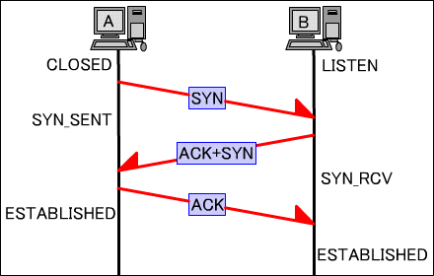
3 Step Handshake

Slide 14
Advantages
There are a number of advantages to using the client server model for web applications:
System can be used by many different customers/employees on different types of computer
Security – customers/employees only have access to their own data
Accessible anywhere 24/7 e.g. Office365/Google Docs
Applications can be updated easily

