Slide 1
Digital literacy for
the love of reading
+

Slide 2
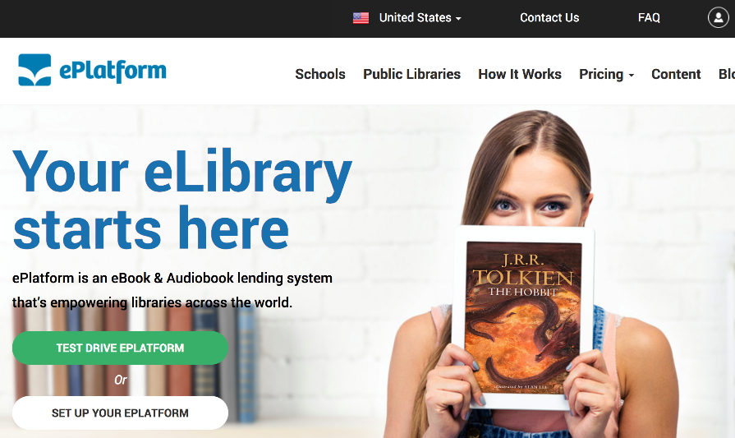
+
What is
ePlatform?
Digital Book Shared Collections
Access the 1,500+ most popular eBook titles and/or 800+ Audiobooks
Multi-Device Digital Library App
Use the simple app on phone or tablet devices + web access from anywhere

Slide 3
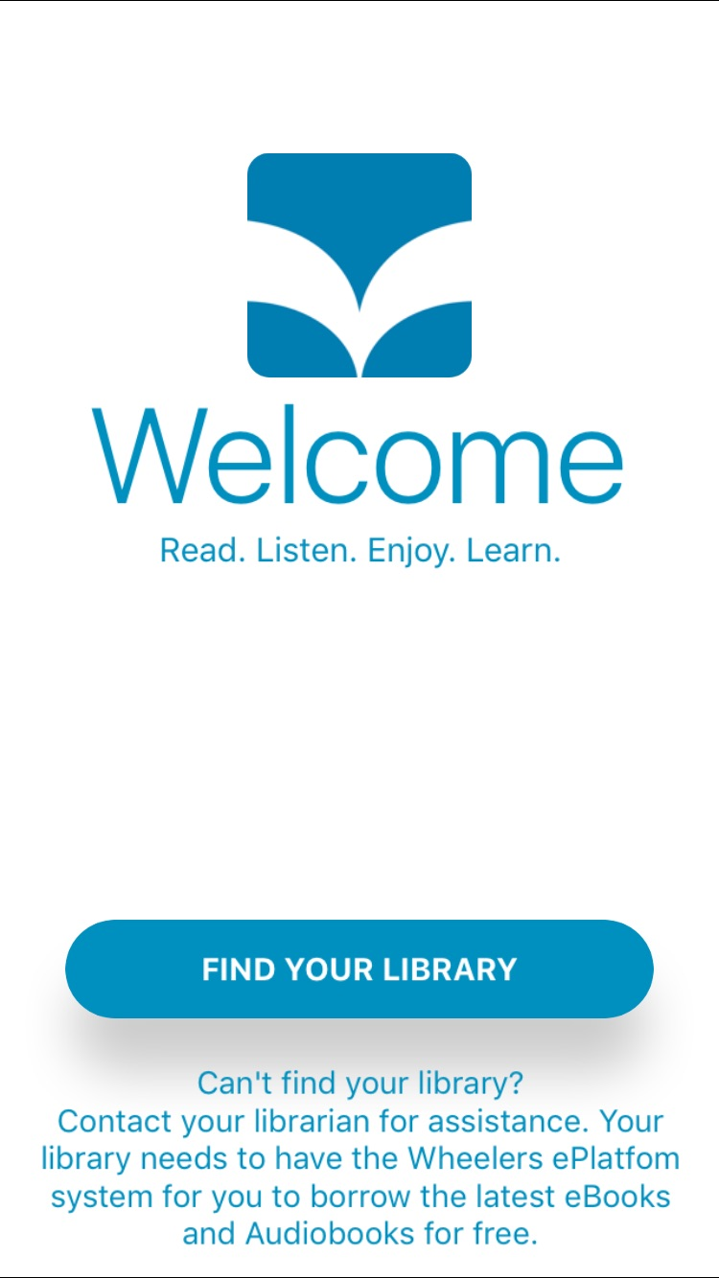
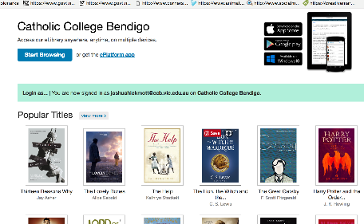
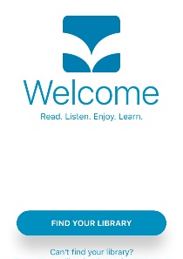
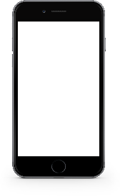
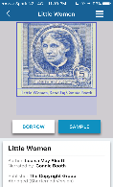
Access library anywhere, anytime by
Downloading the app
Very simple free download
Sync between devices
Offline reading and listening

Slide 4
Rules for using ePlatform app in school:
You can either download the ePlatform app onto your smartphone or use the link in the Reading School area
Login: G-number
Password: same password as for FireFly
Maximum number of titles that a library member can borrow at once- 2
Maximum number of titles that a library member can borrow in a month- 2
Maximum number of days a title can be borrowed for:
In Shared collection- 14 days
In Private Collection- 28 days
Whilst reading an e-book on your mobile phone, place your device on the desk in front of you so that the screen is visible
IMPORTANT: you must still have a physical reading book with you at all times!!

