Slide 1
A Level Physics
Joining in September next year

Slide 2
Course requirements
Preferred entry requirements:
7 in physics and 7 in another science
or 7-7 in dual award science
7 in Maths
Minimum Entry requirements:
6 in Physics and 6 in another science
or 6-6 in dual award science
6 in Maths and 5 in English
Hard work.

Slide 3
What’s different to GCSE Physics?
It’s harder,
but less boring.
More mathematical,
we prefer that you also take A Level Maths
Much common material
More algebra practice
Outside lessons, you’re expected to spend at least 5 hours working on physics each week.

Slide 4
Subject content
Year 12
Uncertainties
Particle Physics
Quantum Physics
Mechanics and materials
Waves and Optics
Electricity
Year 13
Periodic motion
Thermal Physics
Nuclear Physics
Fields
Gravitational
Electric
Magnetic
Capacitors
Astrophysics

Slide 5
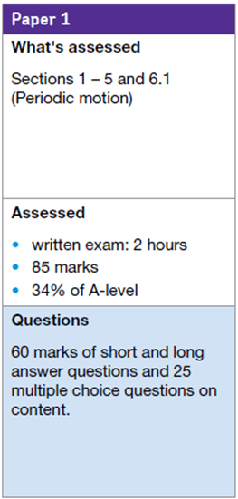
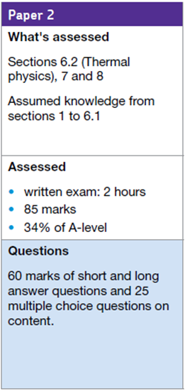
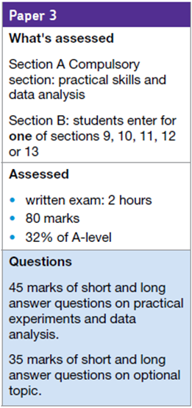
What examinations will I take?

Slide 6
What coursework is there?
Practical skills are assessed in a number of practical activities throughout the course
“Practical Endorsement” is pass or fail and is separate to the A level grade
Based on twelve compulsory practicals, six per year.
Necessary if you wish to study for a science degree at University.

Slide 7
The 12 Required practicals

Slide 8
Two teachers
This is a typical schedule, it differs from year to year

Slide 9
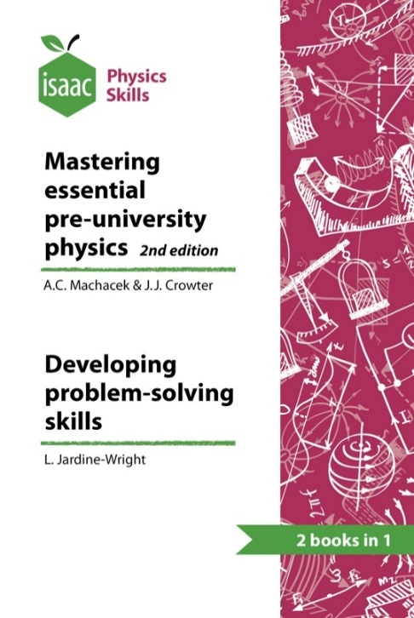
What will you need?
Folder(s)
A4 lined paper
Dividers
Pen, pencil, ruler, calculator
Year 12 Lab book
Isaac Physics textbook (£2*) (optional)

Slide 10
A Level Physics Online
This site has hundreds of videos, and resources for you to download, to help you prepare for your A Level Physics

Slide 11
What books might I need?
AQA Physics A Level
Oxford University Press
Jim Breithaupt
Link to suggested books on Firefly
With links to Amazon

Slide 12
Have I mentioned Isaac Physics?

Slide 13
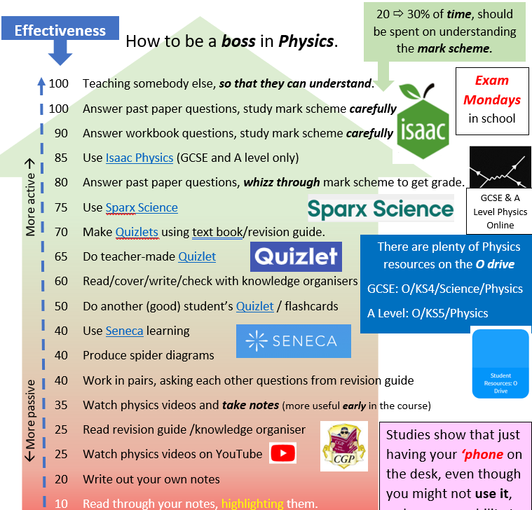
https://wilmslowhigh.fireflycloud.net/physics-1/revision-resources

Slide 14
Physics workshop
Room 104
Every lunchtime
Every Tuesday, after school 3.15 pm to 4 pm
Drop in. Don’t drop out.

Slide 15
Exam Mondays
Some students get part-time jobs in year 12.
Some students even keep them going into year 13… this is almost always not a good idea.
If you do have to do this in year 12 or 13, make sure that you keep Monday after school (until 5:15 pm free, as you will need this for Exam Mondays
We will be scheduling some exams for this slot.
This is the single most important time of the week for you, outside lessons.
When you can practice doing the things you will need to do in the exam hall.

