Slide 1
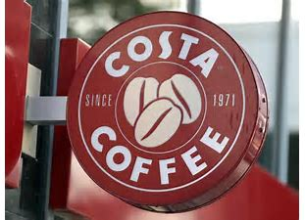
What is Costa Coffee doing during the corona virus outbreak to make sure it survives
Human resource management-(Costa Coffee)
Costa has said that they want to give away free coffee to all of the NHS staff and will try to keep stores open in and near hospitals the few that are open want to stick to all of the governments recommendations of how to deal with the corona virus. In addition to this they want to deliver 1million cans of coffee to other essential workers to help them get through the day. They say that they will still pay the 16000 workers that are not working there full average sum of the week for eight weeks. They have also removed newspapers as they are a large thing that they cant wash and could spread the virus so they are not using them anymore.
Costa coffee has said that’s its number one concern is the safety and wellbeing of its customers and employees. They have said that they are taking every precautions and every step to ensure that the staff and customers are safe. They claim that they are following every health and safety recommendations that the government provide to help make all Costa’s more safe. For example they are more often cleaning all of the tables and chairs. They are also limiting the amount of staff to be in the workplace at one time to prevent over crowding. They are also only accepting card payments, everything will be in one time use cups so that there is no way to spread the disease off cups or plates or knives and forks. They say that there workers will also be fairly treated. Therefore and worker with any symptom of the virus will be sent home and will take all the precautions the government have set like wearing gloves and face masks.
Many people are relying on costa to provide them with coffee so that they can do there jobs properly. They cant close all there stores otherwise they would make a loss that they cant recover from and people wouldn’t be able to provide there service like trains or working for the NHS its is a very fragile relationship if one falls the rest fall, this is why costa are making such an effort to reduce the spreading of corona virus because if costa falls the NHS and other key services could fall after them.

Slide 2
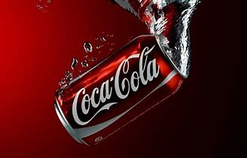
What is Coca Cola doing during the corona virus outbreak to make sure it survives
Finance-(Coca Cola)
Coke stated that at this time of the year, they made a huge loss in sales because of the decline in people shopping for luxury's and more for necessity. Also that two holidays that coke peek sales in have passed with no huge sales due to Covid-19. they state that there sales for there holidays were much lower with place like Australia on buying 50 percent of normal sales so therefore to reduce costs they must reduce the volume of sales to the correct amount for each country in the world.
Coca cola is having a very bad time with there finance due to the spread of Covid-19.The managing director has said that the total debt of match would be about 1.8 billion this year and then the overall debt facilities adding up to approximately 2.6 billion dollars and an average maturity of 5.4 years. Approximately 500 million dollars are committed to undrawn bank facilities available and 920 million dollars in cash that holds a bank deposit. They hope that this will give them a certain amount of flexibility with the current situation. On the 17/04/2020 cokes share value had dropped by five percent to eight pounds and seventy four.
Coca have donated 120 million dollars towards the global relief of covid-19. they have also decided to donate to 11,000 charities in the UK and also the NHS. They have spent money buying more coke delivery vans to distribute to the people that are at risk and need to self isolate. For example older people who cant go to the shops that much will get free coke deliveries. They are also using there advertising methods like billboards in time square to raise awareness about FareShare’s initiatives and encourage others to support them. They have partnered with uber eats so they can also deliver food to people who are at risk and need help to get food and drinks to there house.

Slide 3
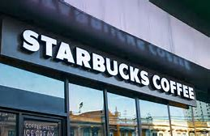
What is Starbucks doing during the corona virus outbreak to make sure it survives
Marketing-(Starbucks)
Starbucks are doing many things to try and keep themselves alive during the Covid-19 crisis. They are mainly using advertising to keep themselves alive and well known. They are donating a lot of money to the key workers that are needed during the pandemic. They also are marketing more on social media because more people are using it now that people can go out less and not see each other. This means that they can target there ads at people who will most likely to buy the products. Most of the advertising is not for the coffee itself but for the online app that they have created. They have made this app because it allows people to order coffees in advance to make que times a lot shorter. A great added bonus for Starbucks is that this makes them look really good because this can greatly reduce the time each person will be in the shop reducing the spread of the corona virus. This could make Starbucks more profit as people that want to stay away from corona will swap from competitors to Starbucks because they will have to wait less and will reduce the exposure of corona that they could have.
Starbucks are trying to encourage people to go though drive throughs because this GREATLY decrease the chance of corona to spread because there are only two people who could make contact. They are doing this by giving special offers to the people who use the drive throughs like buy one get one free, discounts (50%off next coffee) and coupons. This has changed there sales dramatically as there has been and increase in drive though sales by 47 percent but a decrease of sales in the main serving area by 40 percent. This is good because not only are more people going to the drive though, more people in total are coming to Starbucks, this means that it is very likely for the business to be making a profit and can survive though the corona virus outbreak.

Slide 4
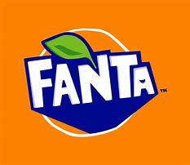
What is costa coffee doing during the corona virus outbreak to make sure it survives
Fanta have expressed some concerns about there main supply coming from china where Covid-19 originated from. This concern is there because they think that their case volume can be affected my Covid-19 by about2-3 percentage point. This is a lot because 2-3 percent could be almost 10 million bottles of Fanta because they have pre made so many so that they can have them spare if needed
Operations-(Fanta)
Fanta has said that its supply chain has been disrupted, this is because in Fanta they use a lot of artificial sweeteners. Most of these sweeteners come from china and because of Covid-19, this makes exporting them almost impossible, this means that the production of Fanta is slowing at a dramatic pace. If Covid-19 stays for a long time they will run out of the sugars and need to completely stop production. This leads to Fanta making a huge loss. Despite this, Fanta claim that there will be no short term problems and production will stay at 100 percent. Personally, I think this could be a bad decision because if Covid-19 stays a long time the production will be cut off abruptly. I think if they lowered production straight away they could produce the same amount over a longer time, they could make more of a profit because there price would increase because there are only a small amount being produced.

