Slide 1
EXTENDED PROJECT QUALIFICATION (EPQ)
Commencing October 2023
To be completed by Summer 2024

Slide 2
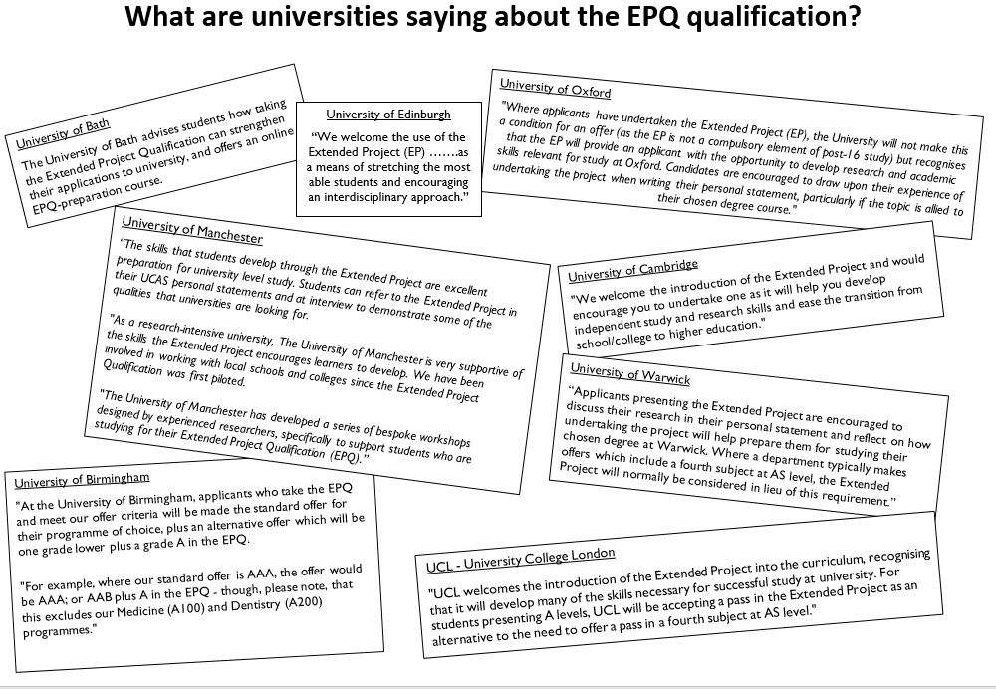

Slide 3
What is it?
Extended piece of research + essay: approx. 7,000 words.
Other options: create a product / performance / conduct an investigation/field study
Opportunity to study something in greater detail
Worth an AS level with UCAS points attached.
Edexcel (Pearson) exam board
Demonstrates you have the independent study skills demanded by employers and universities.
Something to talk about in your personal statement and interview

Slide 4
What type of project can I do?
Dissertation – an extended piece of writing
Field study – an investigation using primary sources
Artefact – eg a piece of artwork, stage set, model etc
Performance – eg a video, theatre, dance

Slide 5
What is involved?
Compile reading/resource list
Independent work: access & assess sources, make notes & summarise arguments
One lesson per week, either 1:1, small groups, or class sessions to explore and practise necessary skills, review progress, action points, support.
The process – how you research the problem – is as important as the outcome (log book is assessed)
The dissertation is 5,000 – 8,000 words

Slide 6
How will I be assessed?
4 main areas you will be assessed on:
Quality of your research – summary of research, analysis of the reliability of sources
Essay/writing – lines of reasoning, conclusion,
Log book – what did you do? Why did you do it that way? What problems did you come across? What did you do to solve them?
Evaluation + Presentation – 10 min summary of project findings and methods followed by 10 mins Q&A

Slide 7
Why should I do an EPQ?
Explore a particular area of interest to you
Complements A Level study
Personal or career reasons
Employers want someone who can show initiative, manage a project, carry out research and summarise different points of view.
Universities want undergraduates who can work independently, carry out effective research, complete extended writing and explore different lines of reasoning.
Both want young people who can manage their workload effectively, meet regular deadlines, reflect on their work, learn from “mistakes” and develop ideas for the future.

Slide 9
Previous titles …
“To what extent does Ivan the Terrible deserve his title?”
“Are sustainable and effective rocket fuels right around the corner?”
“Is lying ever acceptable?”
“Should the rehabilitation of offenders be the main aim of the criminal justice system?”
“Is deforestation justifiable?”
“How is ethnicity used in Shakespeare?”
“Is populism a problem in modern politics?”
“ Can I design and build a remote-controlled buggy?”
“Is it possible to design a household object out of recycled materials?”
“Can we produce a video informing young people of e-safety issues?”
“Can I write a novella in the style of Jane Austen?”

Slide 10
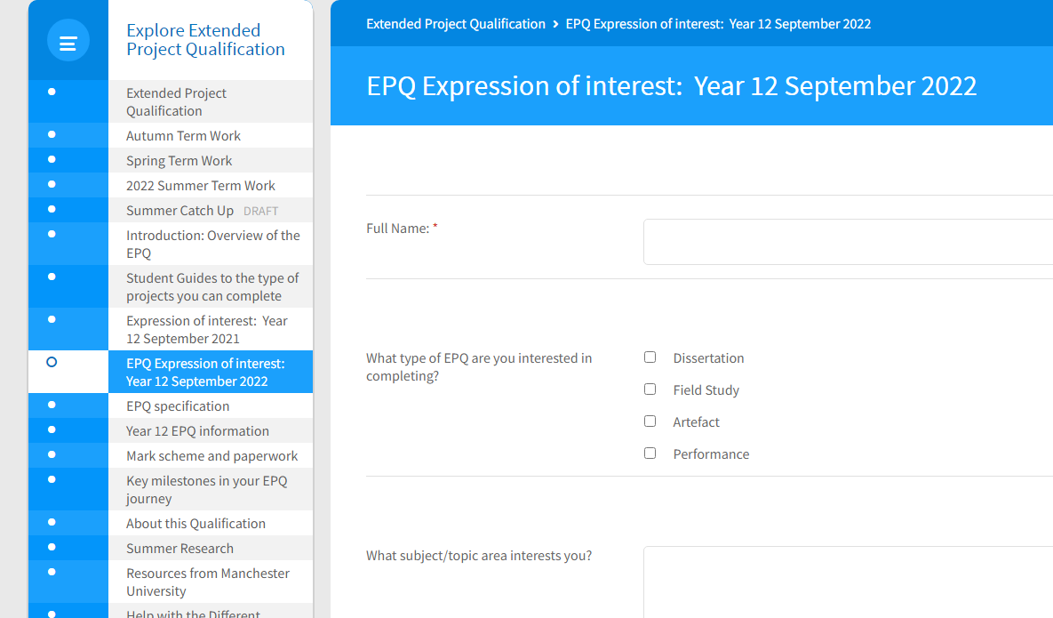
What next?
Complete expression of Interest form on Firefly
https://wilmslowhigh.fireflycloud.net/extended-project-qualification/epq-expression-of-interest-year-12-september-2022
Submit by Friday 29th September 2023

Slide 11
What next?
classes will start very soon after 29th Sept - give guidance on research skills and getting started.
Discuss topics, questions and wording of questions
Talk to staff/other adults about your area of interest – what do they think? Can they recommend resources? Narrow focus?
Start to read everything you can on your chosen topic area, it will help you narrow your topic are and refine your question
Keep a record of everything that you do for your EPQ

Slide 12
Questions?

