Slide 1
Y11- 12 Summer work 2024 Art & Design

Slide 2
Y12 Diagnostic Phase
Project 1: Crustaceans
September to January

Slide 3
A Level: Year 12 at a glance
Time of year | What to expect…
September to January | Diagnostic Phase (Crustaceans Project) Developing skills to an advanced level Drawing, Painting, Textiles, Printing - all fast paced and fun workshops
February to May | Choose a project from Y13 Exam paper Self directed project. Teacher interaction via tutorials in class Outcome: Sketchbook & Final Piece
June & July | Begin Personal Investigation

Slide 4
SUMMERWORK
FOR FIRST LESSON BACK
Due SEPTEMBER 2024
Numbers 4&5 will be marked when we return in September and all these pieces of work will be included in your sketchbooks – have fun and keep me updated via email ☺
Toolkit
Square Sketchbook (Pink Pig)
Create Pinterest Board
4. Fish Painting (A4 Size)
5. Photography

Slide 5
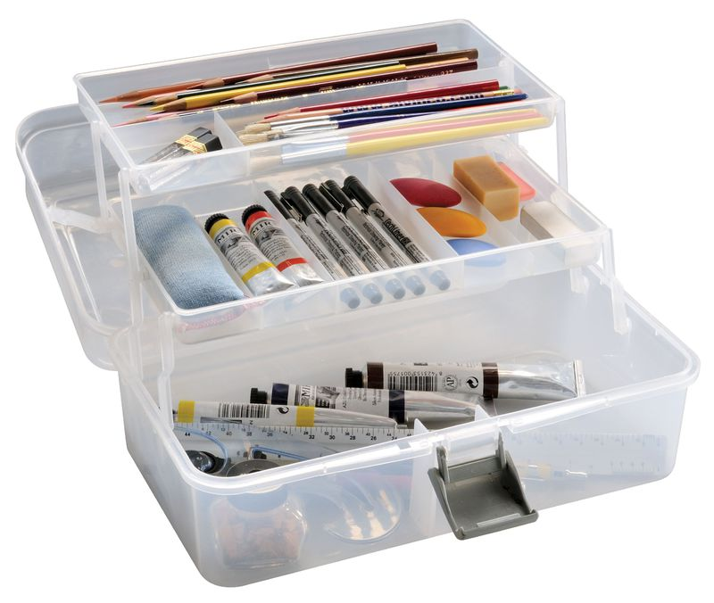
A Level Tool kit
Tool Box:
Water Colours
Acrylic Paints
Oil Paints
Graded Drawing Pencils
Selection of Pens – Fine liners, Sharpie, White Gel, Black Biro
Rubber & Sharpener
Selection of Brushes – Synthetic (easily maintained)
Scissors/Craft Knife
Folder
Lots of Glue!
You must have your own paintbrushes
Essential items to be brought to every lesson.

Slide 6
Buy a Pink Pig 11x11 SQUARE Sketchbook
https://www.the-pink-pig.co.uk/collections/sketchbooks/products/11x11-square-sketchbook-sea-grey?variant=771505029140
You will need it for the first day back.
Please make sure is 11x11 and Square, 35 leaves (pages) and its up to you what colour pages you get.

Slide 7
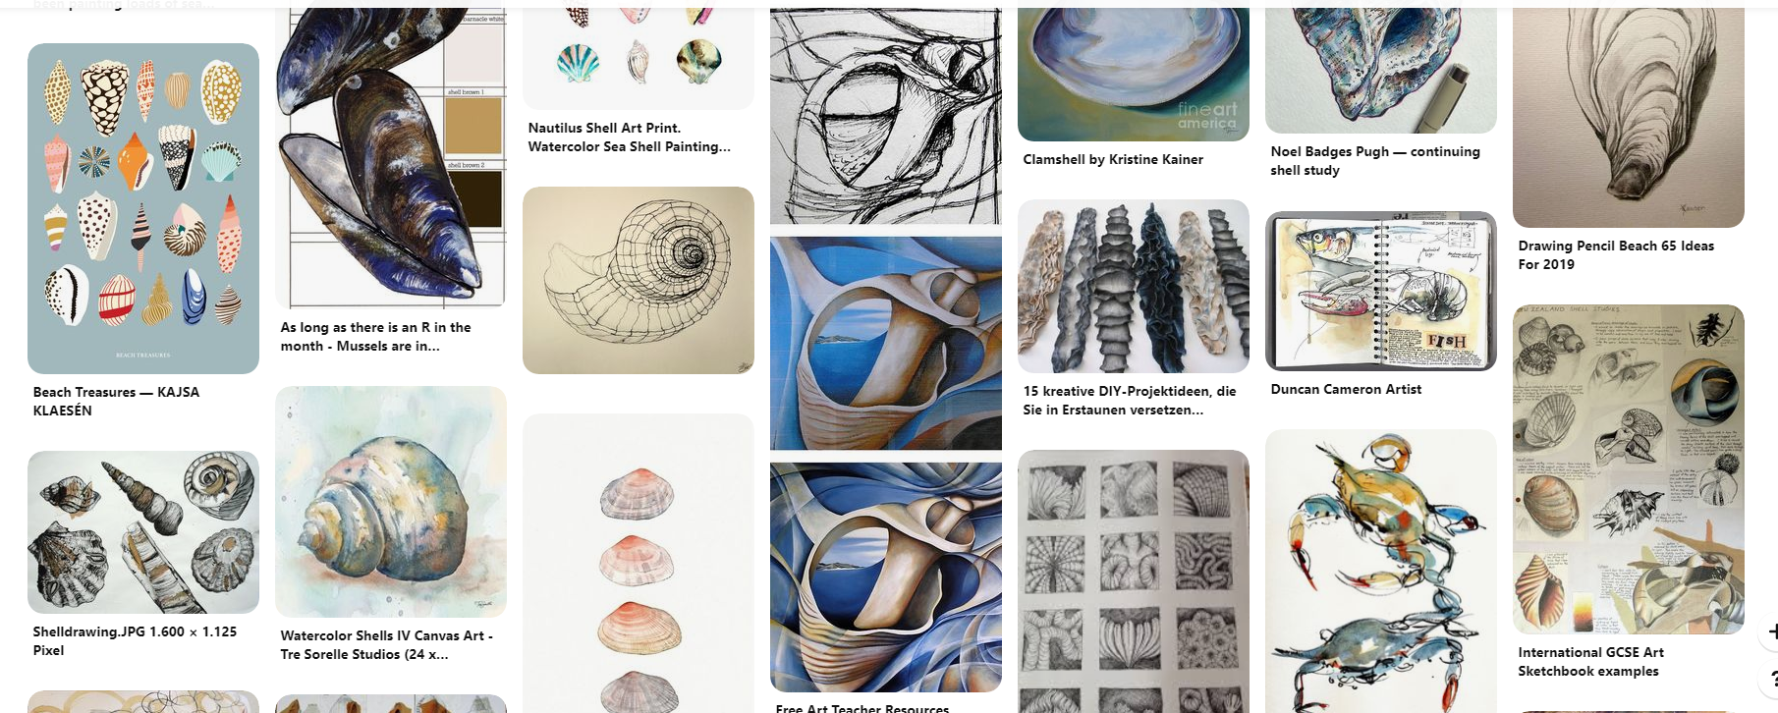
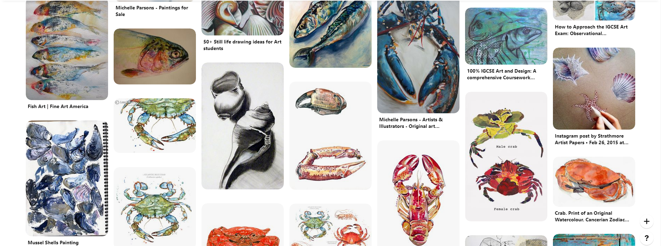
Make a new Pinterest Board – Sealife & Crustaceans

Slide 8
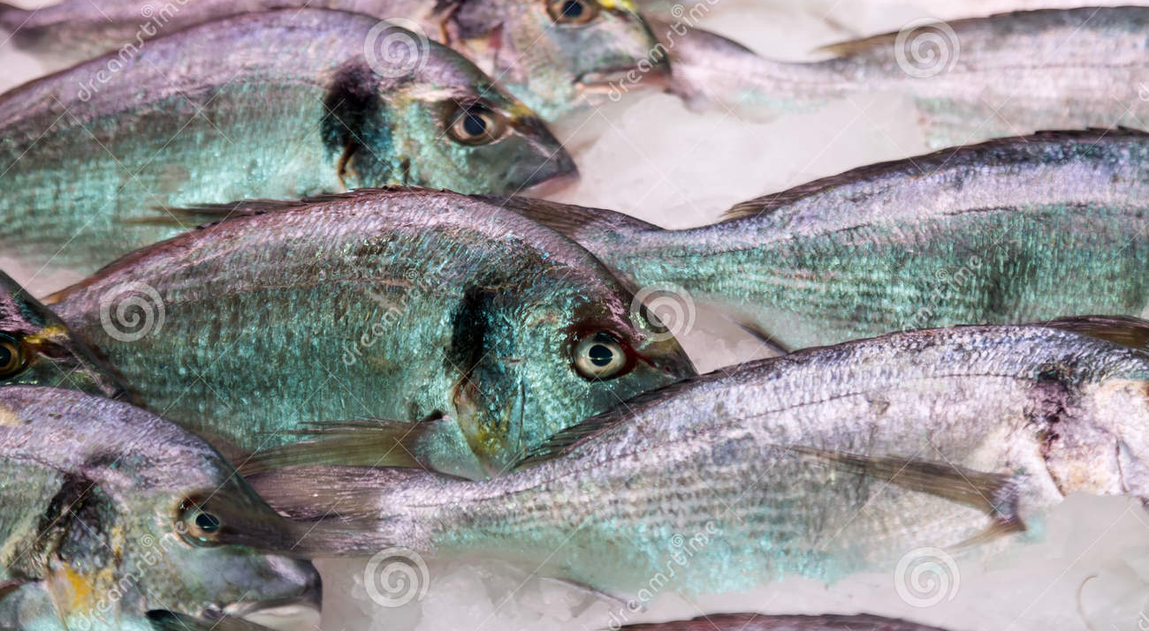
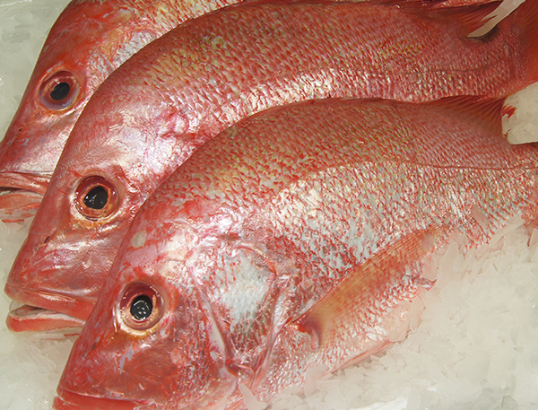
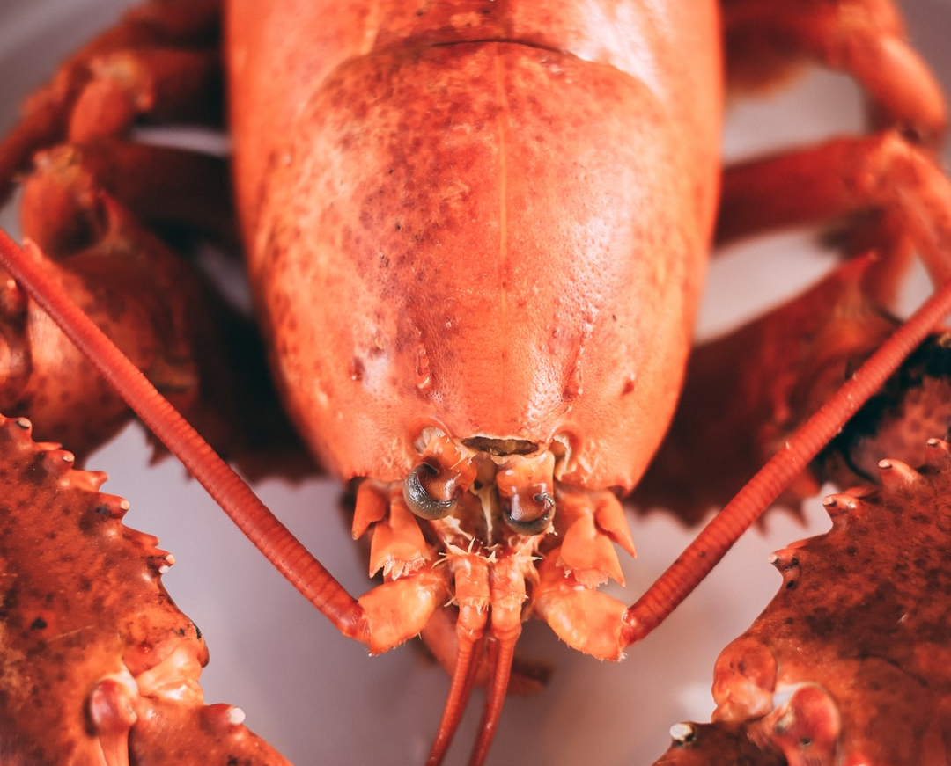
Photography
You will need to take photographs as part of your Crustaceans project.
Where:
Home & School
Aquarium (No gold fishes etc…)
Fish Monger
World Museum Liverpool
Manchester Museum (Natures Library)
How:
Close ups of heads, scales, markings, ridges ect… as well as further away shots and different angles. You will be using these throughout your project so make sure they are clear and good quality photographs. Take lots!!!!
What:
Shellfish
Fish (not tropical!)
Shells
Crustaceans
Crabs
Lobsters
Shrimps
Prawns
Barnacles

Slide 9
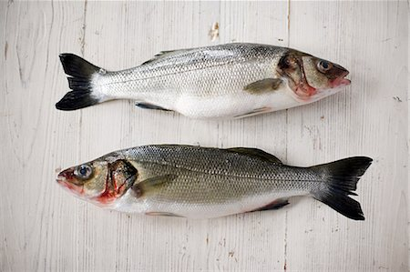
Acrylic Fish
You are to produce an A4 painting of the image on the next slide.
It can be a section of it or the whole image.
It is up to you which style you paint it (examples are attached) but must be in Acrylic Paint.
The fish must look realistic rather than stylised.

Slide 10
Image to paint

Slide 11
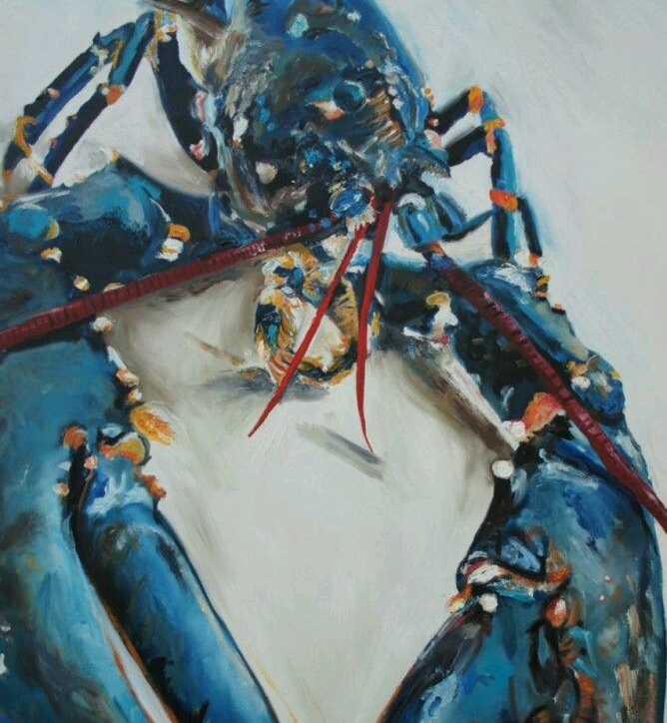
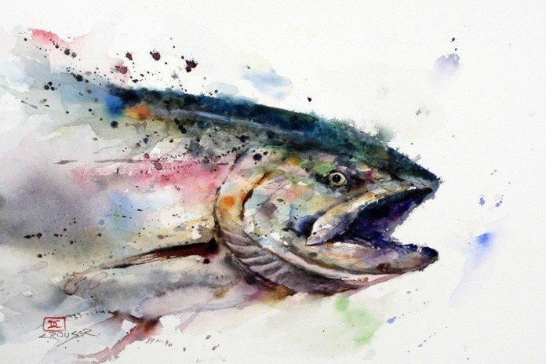
Paint Examples
Notes:
Artist: Dean Crouser

Slide 12
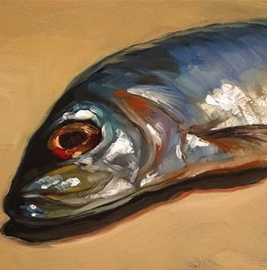
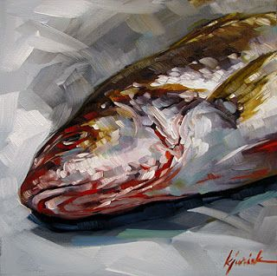
Paint Examples

Slide 13
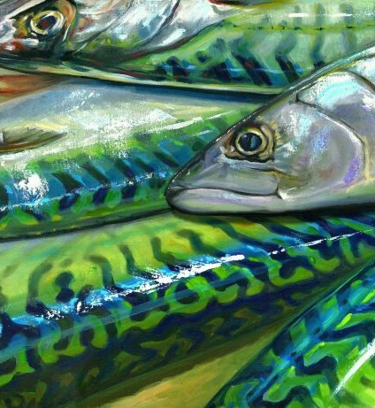
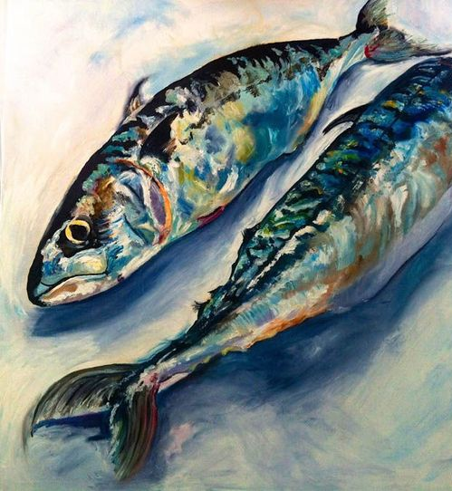
Paint Examples

