Slide 1
Modal verbs in the imperfect tense

Slide 3
Imperfect modal + infinitive (at end)
Have a go at translating:
When I was younger, I was able to play the piano.
As a child, I had to work hard.
We had to buy a new car last year.
They wanted to go to the restaurant.
In the evening, I wasn’t allowed to go out.

Slide 4
Have a go at translating:
When I was younger, I was able to play the piano.
Als ich jünger war, konnte ich Klavier spielen.

Slide 5
Have a go at translating:
2. As a child, I had to work hard.
Als Kind musste ich hart arbeiten.

Slide 6
Have a go at translating:
3. We had to buy a new car last year.
Wir mussten letztes Jahr ein neues Auto kaufen.

Slide 7
Have a go at translating:
4. They wanted to go to the restaurant.
Sie wollten ins Restaurant gehen.

Slide 8
Have a go at translating:
5. In the evening, I wasn’t allowed to go out.
Am Abend durfte ich nicht ausgehen.

Slide 9
Modal verbs in the conditional tense

Slide 11
Have a go at translating:
We would like to work abroad.
I could watch a film.
They ought to/ should read a book.
If she wanted to earn more money, she would have to get a new job.

Slide 12
Have a go at translating:
We would like to work abroad.
Wir möchten im Ausland arbeiten.
2. I could watch a film.
Ich könnte einen Film sehen/ anschauen.
3. They ought to/ should read a book.
Sie sollten ein Buch lesen.
4. If she wanted to earn more money, she would have to get a new job.
Wenn sie mehr Geld verdienen möchte, müsste sie eine neue Arbeit bekommen/ finden.

Slide 13
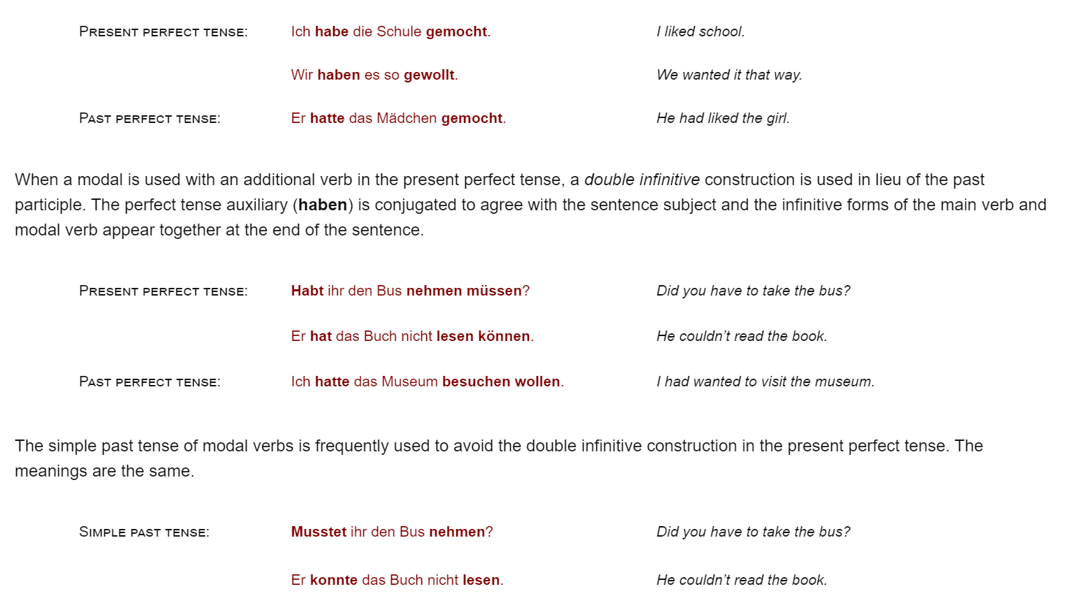
A quick point on the use of modals in the perfect tense:

Slide 14
e.g. ‘Ich sollte das Buch lesen’
I should read the book?
I ought to read the book?
I was supposed to read the book?
(It’s all very ambiguous)
So we might decide to use the perfect tense….. But that means we have two verbs at the end and one is a modal ……… OH NO!

Slide 15
e.g. I was supposed to read the book = ‘Ich sollte das Buch lesen’
But does that mean:
I should read the book?
I was supposed to read the book?
(It’s all very ambiguous)
So we might decide to use the perfect tense….. But that means we have two verbs at the end and one is a modal ……… OH NO!
Ich habe das Buch lesen sollen.

Slide 16
BUT DO NOT WORRY TOO MUCH ABOUT THAT FOR NOW!

Slide 17
To summarise:
Modals in the present tense (ich): will, soll, kann, darf, muss, mag
Modals in the imperfect tense (ich): wollte, sollte, konnte, durfte, musste, mochte
Modals in the conditional tense (ich): wollte, sollte, könnte, dürfte, müsste, möchte
(Don’t worry about the two slides with the pink background for now if you find them tricky)

Slide 18
If you are going through this for revision, I recommend watching the accompanying video.

