Slide 1
ARRAYS 2
GCSE COMPUTER SCIENCE

Slide 2
Objectives
By the end of this session you should be able to:
Recall what a data structure is
Recall what an array is an why arrays are useful
Understand and be able to program with two dimensional arrays

Slide 3
RECAP previous
In the previous session we looked at one dimensional arrays which look at lot like lists* or single column tables
They are called one dimensional because although they might contain many rows they only contain one column
*in Python the closest thing we have to an array is a list

Slide 4
1D Array
cities
Index | Content
0
1 | London
2 | New York
3 | Paris
4 | Munich
A one dimensional array is like a table with many rows but only one column containing data

Slide 5
2D Data
What if we wanted to hold more than one piece of data about each city?
cityInfo
Index | 0 | 1 | 2 | 3
0
1 |  | London | UK | Tower of London
2 |  | New York | USA | Empire State Building
3 |  | Paris | France | Eiffel Tower
4 |  | Munich | Germany | Allianz Arena

Slide 6
2D Array
The solution is to create a two dimensional array
We’ve seen already that we can create an array of strings or an array of numbers (e.g. ints)
We could also create an arrays of arrays…

Slide 7
ARRAY OF ARRAYS
Array of strings – each element of the array dogs is a string
Array of arrays– each element of the array dogs is an array of strings

Slide 8
1D vs. 2D
One dimensional array
Two dimensional array
Has height (rows) only
Has height (rows) and width (columns)
dogs
Index
0 | Max
1 | Sid
2 | Nancy
3 | Jack
dogs
Index | 0 | 1
0 | Max | Heeler
1 | Sid | Cross
2 | Nancy | Heeler
3 | Jack | Jack Russell
Note: A two dimensional array can have more than two columns – it is still a 2 dimensional shape

Slide 9
Rows & Columns
If we imagine a 2D array as a table:
Each array inside the main array represents a row
1
2
3
4
1
2
Each item inside that array (separated by commas) represents a column
This 4 x 2 array has 4 rows and 2 columns

Slide 10
CREATING A 2D ARRAY
We seen already how easy it is to create a 2D array by initialising the array when we create it
If we know the shape of the array but don’t know what data the it is going to contain yet we can just initialise it with empty strings (or zeroes if its’s going to hold number data)

Slide 11
ACCESSING ELEMENTS
Recap that for a 1D array elements are accessed through their index number. Given this array…
What does the following pseudocode print out?
myHoliday ← cities[3]
OUTPUT myHoliday

Slide 12
Accessing 2d elements
Elements in a two dimensional array are accessed in a similar way
However we have to specify a row index and a column index
myDog=dogs[2][1]
What type of dog is myDog?

Slide 13
Python Syntax
myDog=dogs[2][1]
row
column
0
1
2
3
0
1

Slide 14
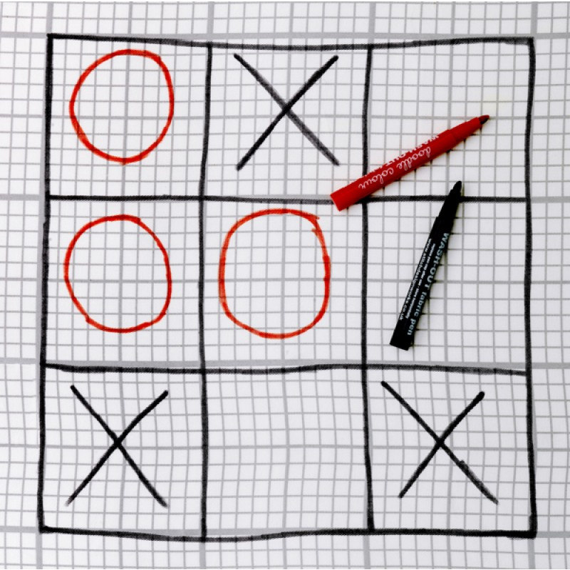
TASK
Can you represent this partially completed noughts and crosses board as a two dimensional array in Python?
Call the array board
Xs and Os are represented by strings e.g. “X”
For blanks insert an empty string e.g. “”

Slide 15
AQA 2D Array
Recall that in AQA pseudocode the first index value of an array is always 1 and not zero
When creating a 1D array in Python we had to add a “dummy” None value at index[0] so our program matched the AQA pseudocode and the first data item in the array was at index[1]
The same applies to 2D arrays but we have to add a “dummy” column as well as a dummy row

Slide 16
Python vs. AQA
What are the dimensions of this array? Remember we ignore the None type
In AQA pseudocode this would be written as
a ← [[0,0,0],[0,0,0],[0,0,0],[0,0,0]]

Slide 17
TASK
Create this array in Python so it matches AQA pseudocode indexing e.g. cityInfo[1][1] ← “London”
cityInfo
Index | 0 | 1 | 2 | 3
0
1 |  | London | UK | Tower of London
2 |  | New York | USA | Empire State Building
3 |  | Paris | France | Eiffel Tower
4 |  | Munich | Germany | Allianz Arena

Slide 18
LOOPING THROUGH 2D ARRAYS
Recall that we can loop through a one dimensional array using the iterator as the array index

Slide 19
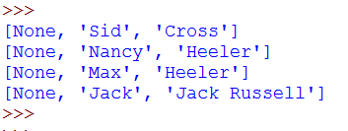
LOOPING THROUGH 2D ARRAYS
We can access the rows of a 2D array in the same way

Slide 20
LOOPING THROUGH 2D ARRAYS
How would you adapt the code on the previous slide so that it just prints out the dog names?
Task
Load up your cityInfo array and, using a loop, print out a list of just the main attractions

Slide 21
LOOP THE LOOP
What about if you want to loop through all the items/elements in an array?
We could use the nested loop structure we saw in earlier lessons:
The iterator for the outer loop corresponds to the row index
The iterator for the inner loop corresponds to the column index
Complete the pseudocode exercise on the next slide

Slide 22
TASK
Create the following algorithm in Python
An array is filled with random numbers generated in groups of 4. Find out exactly how many are divisible by three
divisibleByThree ← 0
randoms ← [[1,4,6,7],[7,4,5,9],[8,4,6,3],[5,4,2,6],[1,6,5,3]]
FOR i ← 1 to 5
FOR j ← 1 to 4
IF randoms[i][j] % 3 == 0
divisibleByThree ← divisibleByThree + 1
ENDIF
ENDFOR
ENDFOR
OUTPUT “Divisible by 3 = ” + divisibleByThree

Slide 23
extension
Extend your code to:
Count the number of values in the array
Sum the values in the array
Output the count, total and number of values not divisible by three
Adapt your code so that the user can look for numbers divisible by 3 or divisible by 2

Slide 24
SUMMARY
A data structure is a collection of different data elements, which are stored together in a structured form
Two dimensional arrays are useful when we want to group together more than one piece of data about an element
A two dimensional array has many rows and two or more columns
Elements of a two dimensional array can be accessed by reference to their row and column index number (starting at 0 in Python but 1 in AQA pseudocode) e.g. cityInfo[4][2]

Slide 25
SELF EVALUATION
Can you define/describe the following:
Data structure ☹ ☺
Array ☹ ☺
1D vs 2D array ☹ ☺
2D array elements ☹ ☺
How AQA array indexes differ from Python ☹ ☺
Now check your skills
I can create a 2D array in Python | ☹ 😐 ☺
I can access individual elements of a 2D array through their index numbers | ☹ 😐 ☺
I can program a single loop that iterates through a 2D array’s rows | ☹ 😐 ☺
I can program a nested loop that iterates through all elements of a 2D array | ☹ 😐 ☺

Slide 26
FURTHER READING/REVISION
http://www.teach-ict.com/gcse_computing/ocr/216_programming/handling_data/miniweb/pg10.htm
http://www.bbc.co.uk/education/guides/z4tf9j6/revision/1
http://www.tutorialspoint.com/python/python_lists.htm
http://learnpythonthehardway.org/book/ex32.html
Note: These are the same links as Arrays1 but worth revisiting here

