Slide 1
The perfect tense

Slide 2
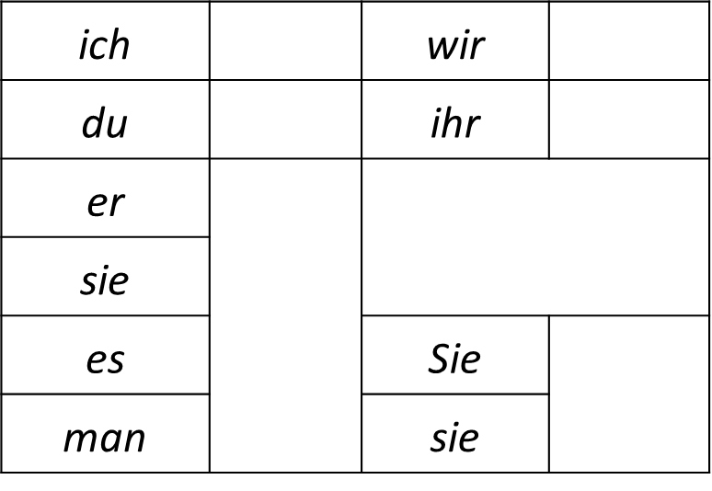
Have a go:
haben
sein

Slide 3
The perfect tense- haben vs. sein

Slide 4
Have a go:
Correct auxiliary?

Slide 5
Have a go:
Correct auxiliary?

Slide 6
Have a go:
Correct auxiliary?

Slide 7
Have a go:
Correct auxiliary?

Slide 8
Have a go:
Correct auxiliary?

Slide 9
Have a go:
Correct auxiliary?

Slide 10
Have a go:
Correct auxiliary?

Slide 11
Have a go:
Correct auxiliary?

Slide 12
Have a go:
Correct auxiliary?

Slide 13
Have a go:
Correct auxiliary?

Slide 14
Have a go:
Correct auxiliary?

Slide 15
Have a go:
Correct auxiliary?

Slide 16
Have a go:
Answers

Slide 17
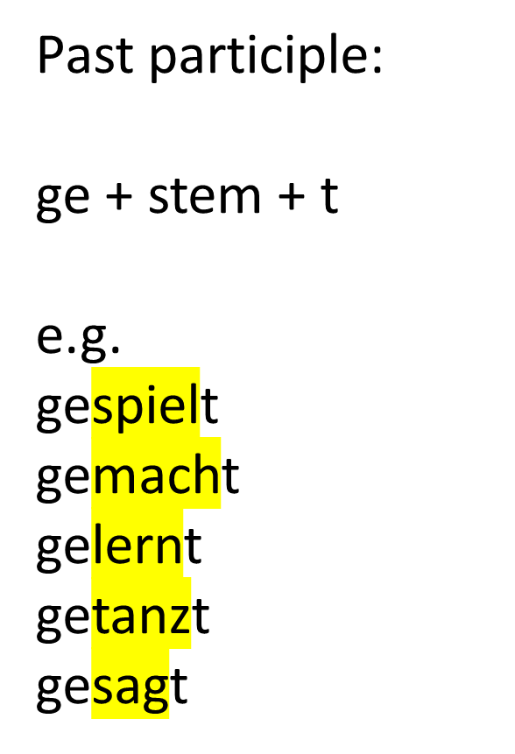
The perfect tense- weak (regular) verbs

Slide 18
The perfect tense- strong (irregular) verbs
A stem change in the present tense= strong
Have a go. Past participle?
lesen

Slide 19
The perfect tense- strong (irregular) verbs
A stem change in the present tense= strong
Have a go. Past participle?
lesen
fahren

Slide 20
The perfect tense- strong (irregular) verbs
A stem change in the present tense= strong
Have a go. Past participle?
lesen
fahren
essen

Slide 21
The perfect tense- strong (irregular) verbs
A stem change in the present tense= strong
Have a go. Past participle?
lesen
fahren
essen
finden

Slide 22
The perfect tense- strong (irregular) verbs
A stem change in the present tense= strong
Have a go. Past participle?
lesen
fahren
essen
finden
gewinnen

Slide 23
The perfect tense- strong (irregular) verbs
A stem change in the present tense= strong
Have a go. Past participle?
lesen
fahren
essen
finden
gewinnen
empfehlen

Slide 24
The perfect tense- strong (irregular) verbs
A stem change in the present tense= strong
Have a go. Past participle?
lesen- gelesen
fahren- gefahren
essen- gegessen
finden- gefunden
gewinnen- gewonnen
empfehlen- empfohlen

Slide 25
As always, it’s not quite that easy….. there are ‘mixed verbs’ (irregular weak verbs)

Slide 26
That was a lot of information…. here’s a recap/ check list:
Haben vs. sein…. do you know which to use and when?
Past participles- weak verbs (do you know how to identify these?)…. included the omission of the ‘ge’
Past participles- strong verbs (do you know how to identify these?)
Past participles- mixed verbs (do you know how to identify these?)
Once you are confident that you can answer all of the above, you need to start learning your verbs! P.81-83 of your grammar book.
(The definitions for these verb types are relevant for the imperfect tense, too….but we’ll save that for another week).

