Slide 1
Modal verbs in the present tense

Slide 3
wollen
sollen
müssen
dürfen
können
mögen (möchten)

Slide 4
wollen = want
sollen = should
müssen = must
dürfen = may/ be allowed
können = can
mögen (möchten) = like/ would like

Slide 5
Tips:
The endings follow a familiar pattern
Expect a vowel change (not for sollen)
Plurals are far more regular
Ich/ er, sie, es, man forms are the same

Slide 6
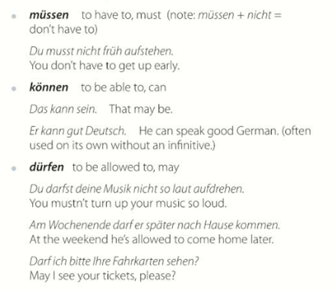
They send the verb to the end as an infinitive:

Slide 7
Grammar book exercises:

Slide 11
https://www.languagesonline.org.uk/German/Grammar/Modal_Verbs/Index.htm
https://german.net/exercises/verbs/modal/
https://wilmslowhigh.fireflycloud.net/german-1/school-closure-quizzes/unit-5/unit-5-lesson-8-modals

